Slide 1
PST 101 Module 5, Lecture 10
“Freedom's just another word for nothin’ left to lose.” -Kris Kristofferson song sung by Janis Joplin

Slide 2
Class Agenda
Announcements
The Competition Point Gap
Assignment

Slide 3
Policy Studies Majors and TAs
Keep the Public Policy Skills in Action book!

Slide 4
Competition Points
PST 101 SOCIETY competition points distribution: The highest group (12) had 29 points. almost twice as many points as the lowest groups (3 and 17) which had 15).
PST 101 as a society is certainly better than America.

Slide 5
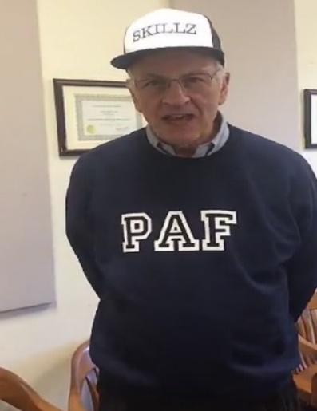
Competition Points on 3/13
Groups | Points
12 | 29
14 | 29
17 | 25
4 | 24
16 | 23
6 | 22
13 | 22
2 | 21
5 | 21
10 | 21
15 | 20
8 | 19
1 | 18
9 | 18
11 | 18
3 | 15
7 | 15
Winners
Losers
As of 3/11/2020

Slide 6
More on PST 101 Equality
No extra credit points were given in Module 4.
On average, the higher groups earned nearly 10 points and the lowest groups at 5 points for the first 3 modules.
Since pts. were not available the normal way for Mods 4 and 5, I will give between 10 and 20 competition points for Module 5.

Slide 7
How to distribute them
If I use the distribution for the first 3 modules, look at the distribution on the next slide.

Slide 8
Distribution according to the past for new points for Mod 4 and 5.
Groups | Points
12 | 20
14 | 20
17 | 16
4 | 15
16 | 12
6 | 12
13 | 12
2 | 12
5 | 12
10 | 12
15 | 12
8 | 12
1 | 11
9 | 10
11 | 10
3 | 10
7 | 10
Winners
Losers
As of 3/11/2020

Slide 9
COVID-19 Consequences
Outside and unexpected events shape socio-economics conditions and therefore policies.
Covid-19 has produced a new distribution of possible points earned for Modules 4 and 5. See the bad news on the next slide.

Slide 10
Added Points
In addition to the points in the chart, some of your may have earned other points through Mod 4 and 5. They will be added on to the points given on the last class.

Slide 11
Why the numbers are like they are.
Notice the middle and upper groups were not hit as hard as the poorer groups just like COVID-19 has hit the lower classes in our society more.
The “SYSTEM” does harm to individuals in different ways and amounts.
Live with it.

Slide 12
The Status Quo Versus Change
How do you feel about the new point distributions?
What are you going to do about those feelings?

Slide 13
Let’s Take a Vote
Using this URL, vote and explain why by 4/23 at 9PM.
https://forms.gle/5v6prVTiTpMu4KGf7
Option 1: Status quo presented on slide 11 (plus what ever other points your might earned from assignments)
Option 2: Each group gets the same number of competition points.*
*Number of points not available for publication at this time and will be based on the voter participation and the quality on the justifications.
Notes:
Spend time on this slide and let it sink in the difference between the percent and a flat deduction. Inform students that each group will have 60 seconds to come together and choose an option.
Only let them see the next slide after they can comprehend the situation.

Slide 14
How to Influence the Vote
Communicate with members of your group and others you know in the class to either maintain the status quo or get as many as Coplin plans to give

Slide 15
Class Survey
Please consider taking the time to complete this survey by 9:00 pm EST 4/24
https://forms.gle/8mAzQRLzUPPup9Wf9
It is not an assignment, but your feedback would be appreciated and valued.

Slide 16
For Next Class
Module 5 due by 12:45 on 4/27 NO LATE PAPERS ACCEPTED! NO REGRADES!
The Key to a Better World – Revealed on Monday!!!

