Slide 1
“Politics is like sex, timing is everything.” -Someone with a filthy mind

Slide 2
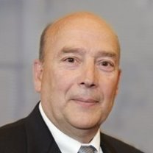
Frank Lazarski
Graduate of Maxwell School (MPA)
Former President of United Way of Central New York
Political Strategy Consultant
Adjunct Professor at Syracuse University

Slide 3
Policy Proposal
Merging Onondaga County and the City of Syracuse Snow Removal
We will be sending you into your groups to come up with a strategy

Slide 4
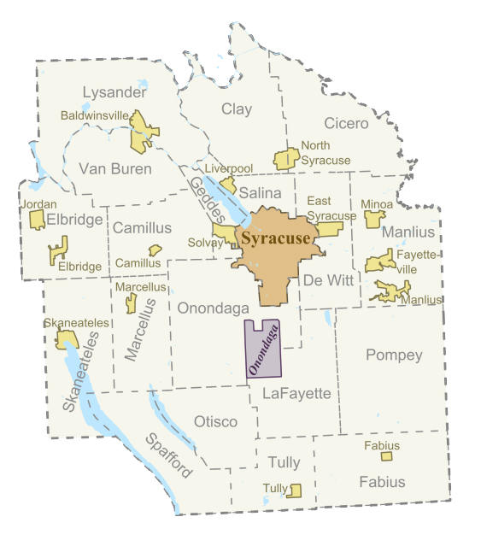

Slide 5
Merging Onondaga County and the City of Syracuse Snow Removal
Players | Position | X | Power | X | Priority | = | Prince Score
County Executive | +4 | X | 4 | X | 4 | = | +64
County Legislators | -3 | X | 4 | X | 3 | = | -36
CSEA (Union for Civil Service) | -5 | X | 2 | X | 3 | = | -30
Syracuse Common Council | -2 | X | 4 | X | 3 | = | -24
Mayor | +4 | X | 1 | X | 3 | = | +12
Sum of Positive Scores and One Half of Neutral Scores Sum of Absolute Values of All Scores, Including Neutral Scores
76 166
.457
= (46%)
=
=

Slide 6
Assignment
State a strategy to gain support from players to implement the policy
Pick a player
State what the player would do
State what the results of the strategy would be
Players | Position | X | Power | X | Priority | = | Prince Score
County Executive | +4 | X | 4 | X | 4 | = | +64
County Legislators | -3 | X | 4 | X | 3 | = | -36
CSEA (Union for Civil Service) | -5 | X | 2 | X | 3 | = | -30
Syracuse Common Council | -2 | X | 4 | X | 3 | = | -24
Mayor | +4 | X | 1 | X | 3 | = | +12

Slide 7
State a strategy to gain support from players to implement the policy
Pick a player
State what the player would do
State what the results of the strategy would be

Slide 8
Group Work Instructions
You will have 15 minutes with your group to complete the assignment
Fill out the template provided to you by your TA
We will call you back in and one member from each group will be asked to share their group’s strategy with the rest of the class
Be prepared to present your work!

Slide 9
For next class
Review Exercise 11.1 and read pages 129-130 in the textbook for next class (note: 11.1 is worth 40 points!)

