Slide 2
Class Agenda
Announcements

Slide 3
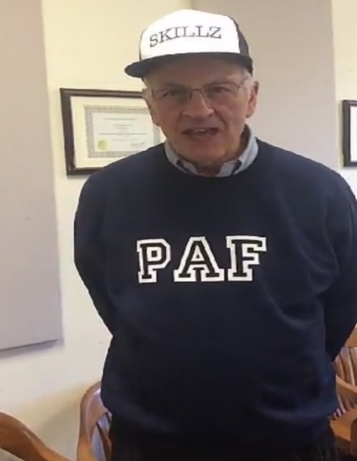
Competition Points
Groups | Points
4 | 9
9 | 9
3 | 8
1 | 7
2 | 7
8 | 7
10 | 7
5 | 6
7 | 6
11 | 6
13 | 6
14 | 6
15 | 6
16 | 6
17 | 6
20 | 6
12 | 5
18 | 5
19 | 5
6 | 4
Winners
Losers
As of 9/16/2019

Slide 4
Speaker Presentation
Be a good listener and questioner!
Raise your hand to ask a question
Good questions will earn your group 1 point, especially if you give Travis a hard time.

Slide 5
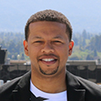
Travis Mason
Graduate of Syracuse University (Undergrad) along with UMich, Harvard, and Princeton
VP of Policy and Head of Regulatory and Certification, Urban Air Mobility Airbus
Worked at Booz Allen Hamilton designing collaborative technology solutions across the Departments of Homeland Security, Defense and State.
Board member of the Maxwell School

Slide 6
For Next Class
Fill out the speaker survey for Travis Mason by 12:45 pm 10/6 or lose 5 points.
Link:

