Slide 1
“Knowledge is power.”
Notes:
Ask: Who wants more educational justice?

Slide 2
Let’s have a discussion about power
Raise your hand and tell us where you are on the continuum on whether or not knowledge is power

Slide 3
Schedule Mod 5
11/2: Intro to Module 5 (Prince Charts)
11/4: More on Prince Charts PP
11/6: Competition Workshop PP
11/8: Competition Debriefing
11/9: Speaker: Minch Lewis??
11/11: Strategies (Chapter 10)
11/13: Frank Lazarski Simulation
11/16: Review Module 5 and 11.1
11/18: Reasons to do good
11/20: Grading America
11/23: Evaluation (Module 5 due)

Slide 4
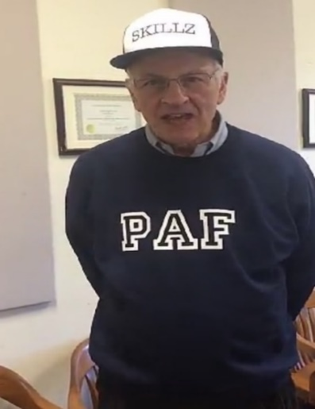
Competition Points on 3/13/20
Groups | Points
12 | 29
14 | 29
17 | 25
4 | 24
16 | 23
6 | 22
13 | 22
2 | 21
5 | 21
10 | 21
15 | 20
8 | 19
1 | 18
9 | 18
11 | 18
3 | 15
7 | 15
Winners
Losers
As of 3/11/2020

Slide 5
Policy Triangle
Players
A
B
Societal
Problems
Public
Policy
C

Slide 6
Follow Along with the Module 5 Exercises Select a policy from your previous modules or not so you can predict its chances of being implemented

Slide 7
The Prince System
What is the Prince System?
A Method for Forecasting Decisions and Coming Up with Strategies to Get What You Want
Notes:
Refer to Triangle Diagram
Clearly State a Solid Public Policy and Use Same In Chapters 7 and 8

Slide 8
Some Users of the System
U.S. Department of State
C.I.A.
U.S. Army Corps of Engineers
U.S. Forestry Service
Diebold Automated Office Programs
American Library Association
Political Risk Services

Slide 9
The Prince System
Step 1
Describing the Policy to be Implemented
Example: Get A New Loan
Notes:
Refer to Triangle Diagram
Clearly State a Solid Public Policy and Use Same In Chapters 7 and 8

Slide 10
Family Issues
Get a New Loan
Pay for Children’s Education
Buy Vacation Home for Parents

Slide 11
The Prince System
Step 2
Identify Key Players
Example:
Father, Mother, Son, Daughter
Is anything missing?

Slide 12
The Prince System
Step 2 Revised
Full List of Key Players
Example: Father, Mother, Son, Daughter, Creditors, Grandparents

Slide 13
The Prince System
Step 3
Estimate Position (-5 to +5)
Players | Position
Father | +5
Mother | - 4
Son | +2
Daughter | +2
Creditors | 0
Grandparents | - 5
Total = 0
Is anything wrong with this great model?
Notes:
Explain why creditors are 0.

Slide 14
Step 4
Estimate Power (1 to 5)
Players | Position | X | Power | = | Prince Score
Father | +5 | X | 3 | = | +15
Mother | - 4 | X | 2 | = | - 8
Son | +2 | X | 1 | = | +2
Daughter | +2 | X | 1 | = | +2
Creditors | 0 | X | 5 | = | (5)
Grandparents | - 5 | X | 5 | = | - 25
Total = -14
Is anything wrong with this enhanced brilliant model?
Notes:
List and Rate 1-3
Not Just Financial
Government Costs are Always There

Slide 15
Step 5
Estimate Priority (1 to 5)
Players | Position | X | Power | X | Priority | = | Prince Score
Father | +5 | X | 3 | X | 5 | = | +75
Mother | - 4 | X | 2 | X | 5 | = | - 40
Son | +2 | X | 1 | X | 1 | = | +2
Daughter | +2 | X | 1 | X | 4 | = | +8
Creditors | 0 | X | 5 | X | 2 | = | (10)
Grandfather | -5 | X | 5 | X | 3 | = | - 75
Total = -30
Notes:
Don’t mix position with priority.

Slide 16
Step 6
Calculate Probabilities
Step 1: Action to be Predicted Get a New Loan
Step 2: Players | Step 3: Position | X | Step 4: Power | X | Step 5: Priority | = | Step 6a: Prince Score
Father | +5 | X | 3 | X | 5 | = | +75
Mother | - 4 | X | 2 | X | 5 | = | - 40
Son | +2 | X | 1 | X | 1 | = | +2
Daughter | +2 | X | 1 | X | 4 | = | +8
Creditors | 0 | X | 5 | X | 2 | = | (10)
Grandparents | -5 | X | 5 | X | 3 | = | - 75
Sum of Positive Scores and One Half of Neutral Scores Sum of Absolute Values of All Scores, Including Neutral Scores
What’s the limitation with the Prince model for making predictions?
Take the poll!
90 210
=
=
.43
Notes:
Touch more on why there are parenthesis around the 10.

Slide 17
Prince Analysis Steps
Identify Necessary Actions
Identify Key Players
Estimate Position (-5 to +5)
Estimate Power (1 to 5)
Estimate Priority (1 to 5)
Calculate Probabilities
Formulate Prince Strategies
Ex. 9.1
Ex. 9.2
Ex. 9.3
Ex. 9.4
Chapter 10

Slide 18
For Next Class
Read Chapter 9 before next class
Module 5 Due 11/23

