Slide 1
“We can be absolutely certain only about things we do not understand.”
-Eric Hoffer, the longshoreman philosopher of San Francisco

Slide 2
Class Agenda
Announcements
Continue Competition Debriefing from last class
Module due on 11/6!

Slide 3
Getting Involved with UBE
Option 1: General Membership
Support UBE, sign petitions, social media, attend a semesterly meeting on what is going on and the goals UBE is working towards
Option 2: Executive Committee
Take PST 410.6 (M/F 3:45-5:05), conduct research, work on initiatives, assist on several tentative projects
Tentative projects: survey, credible history of UBE, program for student feedback on courses and curriculum, education on self advocacy

Slide 4
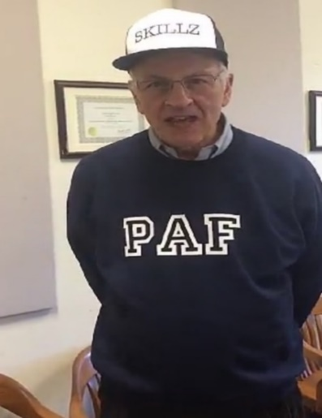
Competition Points
Groups | Points
9 | 36
2 | 34
8 | 32
12 | 31
18 | 30
17 | 29
1 | 28
10 | 28
11 | 28
15 | 28
5 | 27
19 | 27
16 | 26
3 | 25
7 | 25
13 | 25
6 | 24
14 | 24
20 | 24
4 | 21
Winners
Losers
As of 11/4/19

Slide 5
Module 4 Competition
Problem: The dropout rate at Syracuse University in Syracuse, New York is too high.
Proposed Policy: Increase all scholarship assistance to sophomores with above a 3.0 GPA by $2,000.

Slide 6
Data (Historical)
School Year | First Year Drop Out Rate
2016-2017 | 7.6%
2017-2018 | 8.3%
2018-2019 | 9.9%
2019-2020e | 9.1%
Source: Office of Institutional Research and Assessment

Slide 7
Data (Baseline)
School Year | Baseline
2020-2021f | 9.9%
2021-2022f | 10.5%
2022-2023f | 10.7%
From Graph in class on Friday

Slide 8
Exercise 8.5A (Chart)
After carefully reading the discussion in Chapter 8, indicate your three benchmarks in the spaces provided below that include the years chosen in 8.3 and the benchmark.
Baseline
Year | Baseline | Benchmark
2020-2021f | 9.9 | 7.5
Year | Baseline | Benchmark
2021-2022f | 10.5 | Drop out rate of 5.5 or less
Year | Baseline | Benchmark
2022-2023f | 10.7 | 0

Slide 9
Exercise 8.5A (Chart)
After carefully reading the discussion in Chapter 8, indicate your three benchmarks in the spaces provided below that include the years chosen in 8.3 and the benchmark.
Mistake 1: Incomplete title
Baseline and Benchmark Forecast for the First-Year Drop Out Rate at Syracuse University in Syracuse, NY (2020f-2023f)
Year | Baseline | Benchmark
2020-2021f | 9.9% | 7.5%
Year | Baseline | Benchmark
2021-2022f | 10.5% | Drop out rate of 5.5 or less
Year | Baseline | Benchmark
2022-2023f | 10.7% | 0%
Mistake 2: Difference between benchmark and baseline is too high/unrealistic.
Mistake 3: Benchmark should be a specific number, not a phrase.
Mistake 4: Unrealistic benchmark. Can never fully eradicate a problem like dropouts.
Mistake 5: Missing percent signs on baseline and benchmark numbers
Notes:
Problems: 5
Incomplete title
Difference is too high/unrealistic
Benchmark should be a specific number
Unrealistic benchmark. Can never fully eradicate a problem like drop outs.
Missing percent signs on baseline and benchmark numbers

Slide 10
Exercise 8.5B (Justification)
Write a justification indicating why you set the benchmarks quoting at least two justifications from Chapter 8 here:
In 2020-2021, the dropout rate will be reduced to 7.5% because we can expect a fast change.
The following year, the rate will decrease to 5.5% or less because after two years, everyone will know about the policy and will improve their grades, so more people will be able to afford to stay in school and less will drop out.
By 2022-2023, the problem will be eliminated because no one will need to drop out.

Slide 11
Exercise 8.5B (Justification)
Write a justification indicating why you set the benchmarks quoting at least two justifications from Chapter 8 here:
In 2020-2021, the dropout rate will be reduced to 7.5% because we can expect a fast change.
The following year, the rate will decrease to 5.5% or less because after two years, everyone will know about the policy and will improve their grades, so more people will be able to afford to stay in school and less will drop out.
By 2022-2023, the problem will be eliminated because no one will need to drop out.
Mistake 1: Poor justification. Unrealistic based on the historical baseline data.
Correct: ”Pay close attention to the baseline forecast” (Coplin, 2017, p. 101). The benchmark would not be very different because the dropout pattern was steadily getting worse.
Mistake 2: Forecast is incorrect. The benchmark should be an exact number.
Correct: “Estimate how strong government resources are in implementing the policy” (Coplin, 2017, p. 101). SU may not have enough money to give all eligible sophomores $2000 after a while, so the dropout rate will not be lowered drastically.
Mistake 3: Forecast is incorrect and unrealistic. You can never fully eradicate a problem like dropouts.
Correct: The rate will be significantly lower by the third year because scholarship assistance will be widespread and fewer students will drop out. Tuition costs are a “powerful…factor contributing to the societal problem” (Coplin, 2017, p. 101), so we can expect a big impact on the drop out rate.
Notes:
Students must quotes from the guidelines on p. 101-102
Mistakes: 3
1- Poor justification. unrealistic based on the historical baseline data, would not have such a significant decline in such a short period of time.
If you say, “It will drop a lot because it will change fast, you’re not telling me anything.
Should be: ”Pay close attention to the baseline forecast” (Coplin, 2017, p. 101). The benchmark would not be very different because the dropout pattern was steadily getting worse.
2- Forecast is incorrect. The benchmark should be an exact number. Justification is slightly unrealistic, but otherwise takes into account other societal factors contributing to the problem like the cost of tuition, which is one of the 8.5 guidelines.
Should be: “Estimate how strong government resources are in implementing the policy” (Coplin, 2017, p. 101). SU may not have enough money to give all eligible sophomores $2000 after a while, so the dropout rate will not be lowered drastically.
3- Forecast is incorrect and unrealistic. Can never fully eradicate a problem like dropouts.
Should be: The rate will be significantly lower by the third year because scholarship assistance will be widespread and fewer students will be unable to afford to stay in school. This is a ”powerful…factor contributing to the societal problem” (Coplin, 2017, p. 101).

Slide 12
Exercise 8.6 A
Identify a player whom you would present an oral briefing to using the benchmark you developed for Exercise 8.5. List the player’s name, organization and title below.
List the player’s name and organization here: Kent Syverud
List the player’s title here: Teacher of PAF 101
Briefly discuss why you choose this player to receive the memo here: He has influence over undergraduate students in his class.

Slide 13
Exercise 8.6 A
Identify a player whom you would present an oral briefing to using the benchmark you developed for Exercise 8.5. List the player’s name, organization and title below.
List the player’s name and organization here: Kent Syverud
List the player’s title here: Teacher of PAF 101
Briefly discuss why you choose this player to receive the memo here: He has influence over undergraduate students in his class.
Mistake 1: Missing organization.
Correct: Kent Syverud, Syracuse University
Mistake 2: Incorrect title
Correct: Chancellor of Syracuse University
Mistake 3: Poor Justification.
Correct: A reason for Syverud would be that he has direct impact on the decisions made by the Board of Trustees who are responsible for the fiscal policies at Syracuse University.
Notes:
Make sure you get the first group to explain that you are not a player, and bait them into suggesting the Chancellor.
Mistakes: 3
Mistake 1: Missing organization. Should be: Kent Syverud, Syracuse University
Mistake 2: Incorrect title. Title should be Chancellor of Syracuse University
Mistake 3: Poor justification. A reason for Syverud would be that he has direct impact on the decisions made by the Board of Trustees who are responsible for the fiscal policies at Syracuse University.

Slide 14
Exercise 8.6 B
Place a graph that shows the historical pattern, baseline, and benchmark forecasts below. Follow the instructions in the book to create a trend line graph.
Notes:
Mistakes:
Incorrect title
Data labels missing
Incorrect y-axis title
Legend missing
Lines should be all black, no color
Lines must be distinguished by different dashes
Font should be TNR 12 pt
Need source
Must indicate which years are estimated (e) and forecasted (f)
Should not have gridlines
Benchmark is unrealistic because the decrease is too large and fast

Slide 15
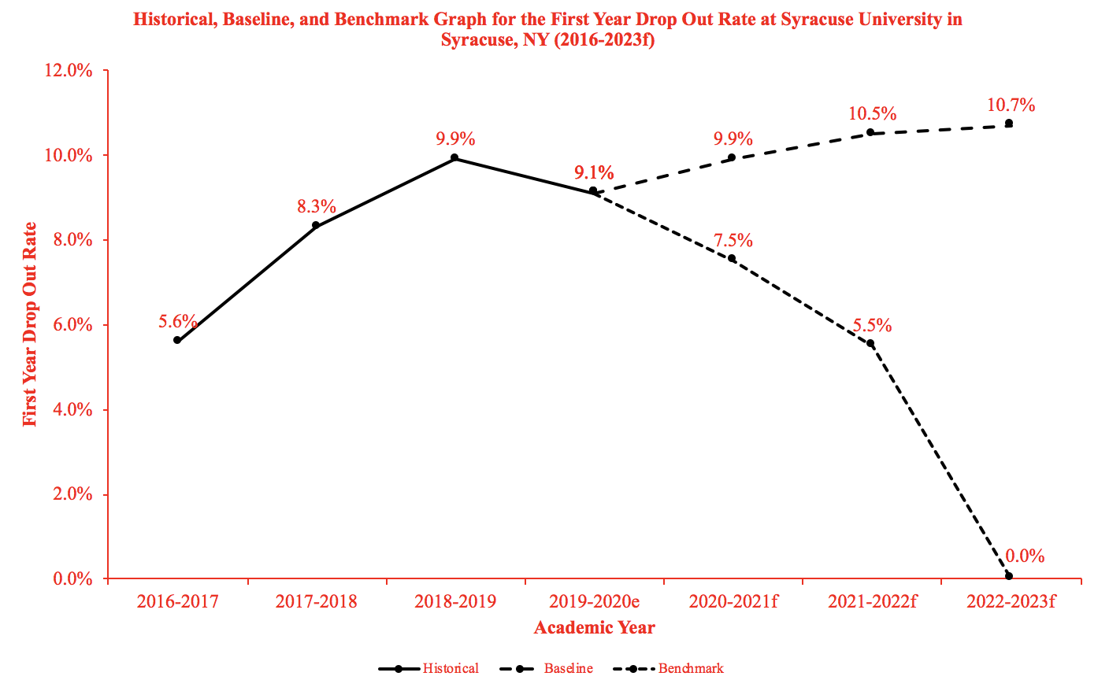
Exercise 8.6 B
Place a graph that shows the historical pattern, baseline, and benchmark forecasts below. Follow the instructions in the book to create a trend line graph.
Mistakes:
Incorrect title
Data labels missing
Missing x and y-axis title
Legend missing
Lines should be black, no color
Lines must be distinguished by different dashes
Font should be TNR 12 pt.
Need source
Incorrect academic years
Should not have gridlines
Tick marks missing
Use black ink for labels
Source: Syracuse University Department of Institutional Research
*DISCLAIMER: Do not make your graph in your module red!!!!!!!!!!!!!
Notes:
Mistakes: 12
Incorrect title
Data labels missing
Missing x and y-axis title
Legend missing
Lines should be black, no color
Lines must be distinguished by different dashes
Font should be TNR 12 pt.
Need source
Incorrect academic years
Should not have gridlines
Tick marks missing
Use black ink for labels

Slide 16
Exercise 8.6 C
In no more than 3 sentences, describe the improvement as specifically as possible that is forecasted for the policy as expressed in the above graph.
Place your response here: If the policy reaches its benchmarks, the drop out rate would be lower than if the policy was not implemented.

Slide 17
Exercise 8.6 C
In no more than 3 sentences, describe the improvement as specifically as possible that is forecasted for the policy as expressed in the above graph.
Place your response here: If the policy reaches its benchmarks, the drop out rate would be lower than if the policy was not implemented.
Mistake 1: Not specific enough. Does not include comparison between baseline forecast and policy forecast.
Should be: In 2020-2021, the baseline percentage of dropouts is 9.9% while the benchmark percentage is 7.5%. The difference between the baseline and the benchmark is 2.4%. The difference between the baseline forecast and the benchmark for the school year 2021-2022 is 5.0%, which shows a steady decrease in the percent of students dropping out of school after the implementation of the policy.
Notes:
Mistakes: 1
Not specific enough. Does not include comparison between baseline forecast and policy forecast.
Ask if anyone can make it more specific.
In this example, we referenced the differences between the first two years of the policy being put into place. For the students modules, it may be better to reference the most recent years instead of older years.

Slide 18
Helpful Hints
Benchmarks can only be set for the years AFTER the policy is implemented.
Label forecasted (f) and estimated (e) data points!
Use the How to get an A on the Graphs in Module 4 (PAF 101 website, Module 4 tab) and follow directions on how to do a graph.
Be realistic with your benchmarks. Just because a policy is implemented does not mean a societal problem will be completely eliminated.
Put a title on data charts (Ex. 8.1)
Look over your competition workshop and debriefing slides for help

Slide 19
For Next Class
Remember: you cannot email your TA with questions within 24 hours of the module being due (12:45 pm, Tuesday, 11/5)
But you can go to TA office hours whenever
Module due Wednesday, 11/6.

