Slide 1
“If you don’t measure results, you can’t tell success from failure.”
~ David Osborne & Ted Gaebler

Slide 2
Agenda
Announcements
Overview of Benchmarking

Slide 3
Module Regrade Instructions
If you believe a mistake was made grading your module, you can submit a regrade form to potentially receive points back
Regrade forms and examples are available under Module 3 “Resources” on the PST 101 Blackboard site
Follow the instructions listed on the regrade form, and use the example for reference to fill out a regrade form
Email the form along with your graded Module 3 paper to Sarah Morin, Head Regrade Director at smorin@syr.edu no later than Friday 10/23
Email Sarah with any questions at smorin@syr.edu

Slide 4
Overview of Benchmarking
8.1-Provide Historical Data on Societal Problem
8.2-Calculate Percent Change Using Excel
8.3-Decide on Years to Use in Your Benchmarks
8.4-Make a Baseline Forecast
8.5-Setting Your Benchmark
8.6-Use Benchmarks to Support Policy Proposal

Slide 5
What is a benchmark?
A measureable goal of your societal problem that you hope your policy will achieve

Slide 6
Benchmarking Example
Great Bathroom Debate
72% Over the top of the roll
25% Under the roll
3% Not discernible
What’s the benchmark?

Slide 7
What to Benchmark
The policy you indicated in Exercise 7.1
A measurable goal for the societal problem you policy seeks to improve.

Slide 8
Ex. 8.1: Historical Data
One piece of real data at a minimum
Provide source for real data and rationale for estimates
Print out data source and circle the number
Refer to Figure 8.1 on pg. 94 in the Policy in Action book
4 Years ending in most recent calendar year
Notes:
5.2 in Mod 3 It might be worthwhile to add that the 4 yrs must end at 2018- anyone looking solely at the presentation from the PAF website without class notes won’t have this information…
Academic Years will end in 2018-2019e

Slide 9
Where have you used historical data (8.1) before and in what module?
Raise your hand to give us your answer for an extra credit point

Slide 10
Dates Used in 8.1
In most cases, use the calendar year (i.e. 2020)
In cases dealing with schools, use the academic year (i.e. 2020-2021)

Slide 11
Academic Years Example
Enough of this academic year has passed to estimate for the rest of it.
The last piece of historical data should be 2019-2020e
School Year | First Year Drop Out Rate
2016-2017 | 7.6%
2017-2018 | 8.3%
2018-2019 | 9.9%
2019-2020e | 9.1%
Source: Office of Institutional Research & Assessment
Notes:
A policy implemented in 2019-2020f could have benchmark data that year (2019-2020f) depending on the nature of the policy. Others will have to wait till 2020-2021f for their first benchmark.
-Emphasize that the years need to be consistent (ex: all 1 year apart from last)

Slide 12
8.2B Chart Example
Figure 8.1: Data on the Number of Larcenies in Residence Halls at Citrus University, per 1,000 students, 2016-2020e
Time Period | Number of Larcenies | Source of Rationale
2016-2017 | 136 | Citrus Univ. Security Dept. Annual Report, 2017
2017-2018 | 123 | Citrus Univ. Security Dept. Annual Report, 2018
2018-2019 | 142 | Citrus Univ. Security Dept. Annual Report, 2019
2019-2020e | 126 | Between July and December 2019, 63 larcenies were reported. The estimate was made for all of 2019-2020e doubling that number because about the same number of larcenies occur each sixth month period.
Years don’t have to be consecutive but must have same intervals between them
Notes:
Emphasize that the last historical year must be 2017-2018, not 2018-2019e. 2017-2018 should only be estimated if the relevant data has yet to be released.

Slide 13
Ex. 8.2A: How to Calculate Percent Change
Figure 8.1: Data on the Number of Larcenies in Residence Halls at Citrus University, per 1,000 students, 2016-2020e
Time Period | Number of Larcenies | Source of Rationale
2016-2017 | 136 | Citrus Univ. Security Dept. Annual Report, 2017
2017-2018 | 123 | Citrus Univ. Security Dept. Annual Report, 2018
2018-2019 | 142 | Citrus Univ. Security Dept. Annual Report, 2019
2019-2020e | 126 | Between July and December 2019, 63 larcenies were reported. The estimate was made for all of 2019-2020e doubling that number because about the same number of larcenies occur each sixth month period.
Percent Change equals
[(new figure – old figure) ÷ old figure] x 100
Ex: [(123-136)/136]*100 = -9.6%

Slide 14
Ex. 8.2B Chart Example
Without Excel between years 1 and 2 (8.2A)
With Excel for the chart (8.2B)
Here is what the print out will look like if you do it correctly:
Time Period | Number of Larcenies per 1000 Students | Percentage Change
2016-2017 | 136
2017-2018 | 123 | -9.6%
2018-2019 | 142 | 15.4%
2019-2020e | 126 | -11.3%
Compare 2016-2017 to 2019-2020e |  | -7.4%
Notes:
-include that the change from year 1 to 2 is the only calculation that must be shown and typed out- just to clear up confusion from today’s class
-There is an example online of how to do this SO USE IT!!!

Slide 15
Ex. 8.3: Deciding on the Years to Use Benchmarks
How many years will it take for the policy to have the intended impact?
Example: If your policy goes into effect in 2020, start with 2021
Choose 3 years
Can be consecutive or not
Benchmark can be the same or not
Notes:
-Education must be academic years.
-Explain it does not need to start next year, could be 3 to 4 years out.

Slide 16
Exercise 8.4: Baseline Forecast
“Baseline Forecast” means what happens in the future assuming the policy did not go into effect

Slide 17
Three Approaches to Making a Good Baseline Forecast for your Societal Problem
Assume what has happened in past will continue (see exceptions on next slide)
If pattern has been consistent: use percent change or average percent change to make forecast
If historical data has inconsistent pattern: Follow ups and downs, keeping overall percentage change the same

Slide 18
Exercise 8.4: Baseline Forecast Cont’d
Consider conditions that will change the trend
Major outside event (ex: economic growth, pandemic)
Trend approaching outer limit
Demographic factors
Cyclical pattern

Slide 19
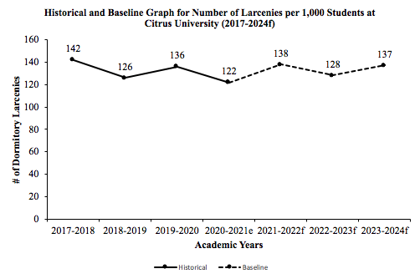
Citrus Trend line
Figure 8.3-
Notes:
-Mention that “f” for forecast

Slide 20
Exercise 8.5: Choosing Benchmarks
Pay close attention to baseline forecast
Decide how powerful factors contributing to societal problem are
Estimate strength of government resources in implementing policy
Compare to similar areas with similar policies
Use authoritative sources

Slide 21
Exercise 8.5: Choosing Benchmarks Cont’d
Historical, Baseline forecast, and Benchmark Graph for Number of Larcenies at Citrus University per 1,000 students. Policy is training sessions for resident students.
Notes:
Example:
Make Benchmark on GPA for when you graduate from SU
-Wants standard (Magna Cum Laude)
-comparison to siblings
-comparison to past performances
Following this format in Excel will produce the graph required in 8.6B
-TALK ABOUT JUSTIFICATIONS IN DETAIL
-emphasize that two of the five guidelines from ch. 8 must be quoted in justifications

Slide 22
Exercise 8.6
Using your Benchmark to support your policy
Presentations to players should be short and to the point
Create a graph showing trend line, baseline and policy forecast
Notes:
The sentence should be structured:
“This policy will reduce _______ by X%.”
-Give specific rate in the sentence between baseline and benchmark

Slide 23
Module 4 Graphs
Follow How to Get an A on the Graphs!!!
Found under Module 4 tab of the PST 101 website
Read directions carefully + pay attention to detail
= NO POINTS LOST ☺

Slide 24
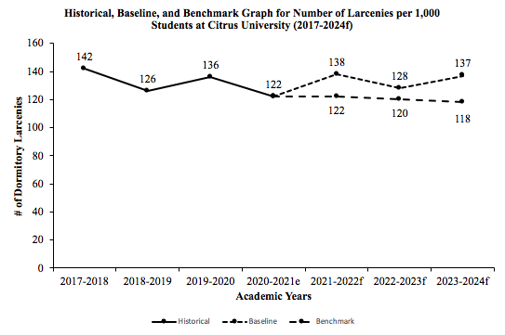
Trend line/Baseline Graph
Notes:
-Should explain that e means estimate and f means forecast
-talk about what the graph should look like if you are skipping years

Slide 25
Exercise 8.6c
Compare baseline forecast to policy forecast in specific detail
Example: If the policy works, the improvement over the baseline will be x%
BE REALISTIC
Notes:
Give concrete example

Slide 26
Trendline Homework Due 10/23
Exercises 8.4 and 8.6 require a graph that you will need to practice.
Complete the Trendline Homework on Blackboard and send to your TA by next class at 12:45 PM or lose 5 points.
If your entire group does it, you will receive 3 extra credit points.

Slide 27
For Next Class
Trendline Homework due by 12:45 PM on 10/23
Submit Exercises 8.1 and 8.2 to your TA in an email by 12:45 PM on 10/23
Login to Zoom workshop provided by your TA at 12:45 PM on 10/23
Download the Module 4 Competition Word Document from Blackboard to have it available during the workshop on Zoom

