Slide 1
“The first thing we do,
let’s kill all the lawyers.”
~William Shakespeare
Notes:
From David McCullough’s John Adams p. 91 who says it is a paraphrase from Cato and frequently used by George Washington.
Ask: Who wants more educational justice?

Slide 2
Renee’s Reaction
“Except mine!”

Slide 3
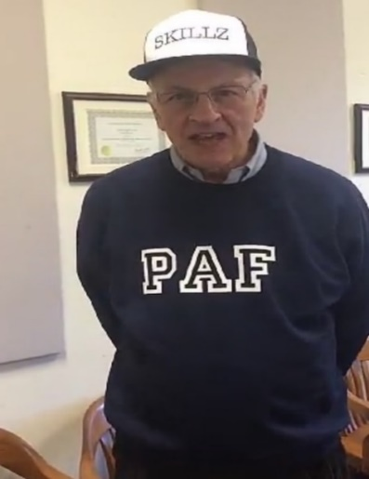
Competition Points
Groups | Points
12 | 29
14 | 29
17 | 25
4 | 24
16 | 23
6 | 22
13 | 22
2 | 21
5 | 21
10 | 21
15 | 20
8 | 19
1 | 18
9 | 18
11 | 18
3 | 15
7 | 15
Winners
Losers
As of 3/11/2020

Slide 4
Reminder: Apply to be a TA!
Who: Lovers of PST (you do NOT need to be a PST major), hard workers, leaders, those with an A- or A
What: Be a TA for PST 101 – Spring 2021
When: The application, which is on the website under the TA tab, is due (emailed to Joanna) TONIGHT by 8PM
How: Complete the application and an interview, end the course with an A- or A, be chosen
Questions? Email Joanna at jcvines@syr.edu

Slide 5
Speaker Surveys
After each speaker there will be a link in the PowerPoint to a survey
You must fill out the survey before 12:45pm on the date of the next class or lose 5 points
For any questions or concerns regarding speaker surveys please email Alexandra Whitcomb at awhitcom@syr.edu

Slide 6
Speaker Presentation
Be a good listener and questioner!
Raise your hand to ask a question
Good questions will get you 1 point for your group, especially if you give Renee a hard time

Slide 7
Renee Captor
1980 - SU Graduate-Policy Studies Major
1982 - SU Law Graduate
2017- Case Western Reserve University- MA in Financial Integrity
Defense Attorney from 1983 – 2001
Executive Director OCBA Assigned Counsel Program, Inc. 2001 – 2016
Teaches PST 431: Criminal Justice (Spring)
Attorney Advisor, Social Security Administration, Office of Disability Adjudication and Review 2018-date
315-476-6310
flam1ngo@aol.com

Slide 8
For Next Class
Speaker survey for Renee Captor due next class at 12:45 PM or LOSE 5 POINTS
https://syracuseuniversity.qualtrics.com/jfe/form/SV_1NA9eefn69oUEHX

