Slide 1


“No one can make you feel inferior without your consent.”
-Eleanor Roosevelt
Always pleasing others
Always pleasing yourself

Slide 2
Class Agenda
Announcements
Exercise 2.5 Clarification
Chapter 3 Overview
Designing a Survey
Competition Workshop Topic
Assignment for Next Class

Slide 3
Email Etiquette
Organized subject line
  This should only be a few words
Professional greeting
  With the title of the person you are emailing if applicable
A quick greeting
  Don’t jump right into content
  Keep it short, don’t get personal
Don’t write a story for the body of the email, just get your point across
Close it out with a thank you and a signature if applicable
This is applicable when emailing your TA, but is a lifelong SKILL.

Slide 4
Include the email string!
Provides context
So people don’t have to search for your damn previous email
Especially when using reply all

Slide 5
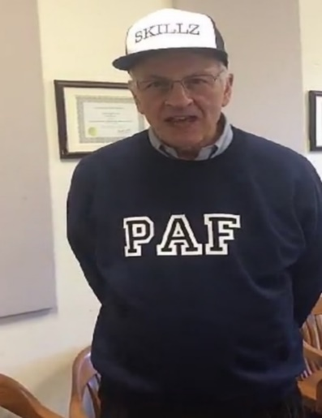
Competition Points
Groups | Points
2 | 5
4 | 4
8 | 4
11 | 4
13 | 4
5 | 3
9 | 3
14 | 3
7 | 2
10 | 2
12 | 2
15 | 2
17 | 2
1 | 1
16 | 1
3 | 0
6 | 0
Winners
Losers
As of 09/18/2020

Slide 6
Exercise 2.5 Clarification
If 2010 Census data is available, use that on your exercise.
If 2010 data is NOT available, use the most recent time period of data that American Fact Finder provides for that category.
Don’t put % sign or $ sign with your table answers or you will lose a point
% Persons 65 years and older | 14.5

Slide 7
Chapter 3
Finding players or experts

Slide 8
Gathering Information From Players and Experts
Exercise 3.1—Selecting three players who deal with your specific societal problem in your selected topic
Part A: an elected government official
Part B: a non-elected player from a government department
Part C: a local, state or national non-profit organization, public interest/lobby group, or political organization
Exercise 4.1—Selecting a player from Exercise 3.1 to be your client

Slide 9
Finding and Serving Clients
Must be a Player
Look at Triangle
Players
Societal
Problems
Public
Policy
Notes:
2 General and national
3 state and local for client- also non-profit
-Ask for examples
-*Encourage competition for points*
-Say how player could use surveys to find out about other players, policy, or society

Slide 10
The Chancellor wants to know if dog do-do is a problem on the QUAD
CENSORED
Notes:
Note:
Introduction to Chancellor’s problem with dog shit
-Explain correlation to Chapter 4 (designing a survey)

Slide 11
Advice on Exercise 4.1B
Read the six bullets in the next 2 minutes
Player MUST BE real, but answers can be hypothetical
For the player quote, include the APA citation for “personal communication” whether real or hypothetical
Watch out for attitudinal vs. factual

Slide 12
Key Concepts: Target Population
Target Population:
  The total specifically defined set of people about whom you want to gather information.
  Student Response: What should the target population be for the Chancellor’s problem?
Notes:
Students need to understand this better

Slide 13
Key Concepts: Sampling
Sampling Frame:
  A subset of the population to be surveyed
Sample—those who respond
Random:
  Each member of the target population has an equal chance of being in the sample

Slide 14



EX. 4.2 Four Methods of Contact
Coplin
Email/Online
Mail
Coplin
Face-to-Face
Telephone
Notes:
Ask for Pros and Cons of each
*To encourage competiton* ASK: What is the response rate for each?
…IF THEY READ CHAPTER 4 THEY SHOULD KNOW!

Slide 15
EX. 4.2B Is Your Sample Good?
Target
Population
Sample
 | Number | Percent (%) | Number | Percent (%)
Lower Division | 1800 | 53 | 183 | 54
Upper Division | 1600 | 47 | 155 | 46
Total | 3400 | 100 | 338 | 100
Notes:
Why is this a good variable to check representativeness of the sample.
Variable is Upper vs. Lower divisions

Slide 16
EX. 4.3 Estimating Sample Size
Required contacts = Desired sample size
Expected response rate
For example, if you desire a sample
size of 250, and you expect a
response rate of 40%, the following
formula shows that you would need
to contact 625 individuals:
625 = 250
.40
Public Policy Skills in Action p. 57
Notes:
Stress the formula more and that students must estimate and justify the response

Slide 17
EX 4.3 Sample Size Hint
Do NOT select a sample size of more than 2500 people!

Slide 18
EX. 4.4 Types of Questions
Open
vs.
Closed
Notes:
Ask for an example

Slide 19
Two Closed Choice Questions
Attitudinal
Factual
Notes:
Give examples of each during lecture and differentiate by comparing the two

Slide 20
Module 2 Competition | Topic
The Chancellor of Syracuse University, Kent Syverud, asked for the design of a survey to assess what undergraduates think of his leadership on campus.
For class Wednesday, your TA will send you a separate zoom link, where you will work on the exercises in Chapter 4.1-4.4

Slide 21
For Next Class
Complete Exercise 4.1 A & B on topic and email it to your TA by 11:00am on Wednesday 9/23 or lose 5 points
Login to Zoom workshop provided by your TA at 12:45 PM on Wednesday 9/23
Download the Module 2 Competition Word Document from Blackboard to have it available during the workshop on Zoom
Don’t pack up-alumni speaker

Slide 22
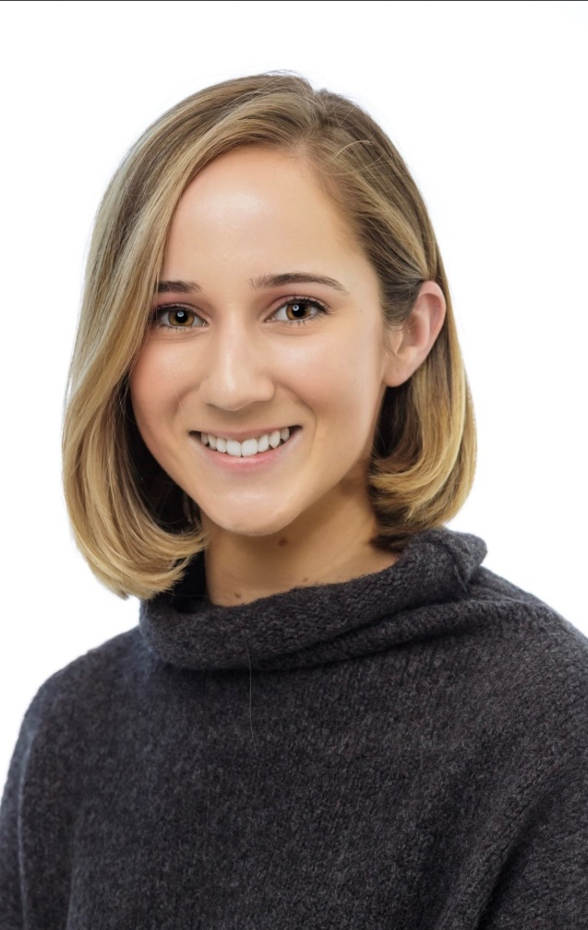
Contact Info: canela.corrales@citi.com
Job Opportunities: https://features.citi.com/ourprograms
WHAT I DON’T DO
Deal with payroll
Deal with employee complaints
Tell employees about their healthcare benefits
WHAT I DO
HR Advisor for Global Consumer Bank
Partner with business leaders to help execute their people and talent goals
Basically a Coplin for the bank
90% Dale Carnegie
Lateral Talent Acquisition for Enterprise Infrastructure, Consumer and Private Bank Technology
Work on recruiting strategy (events, sourcing, branding)
Think of ways to get people to work for us and make us look “cool”
50% Dale Carnegie, 50% Excel
Canela Corrales
HR Analyst at Citigroup
Policy Studies, IM&T
Class of 2019

Slide 23
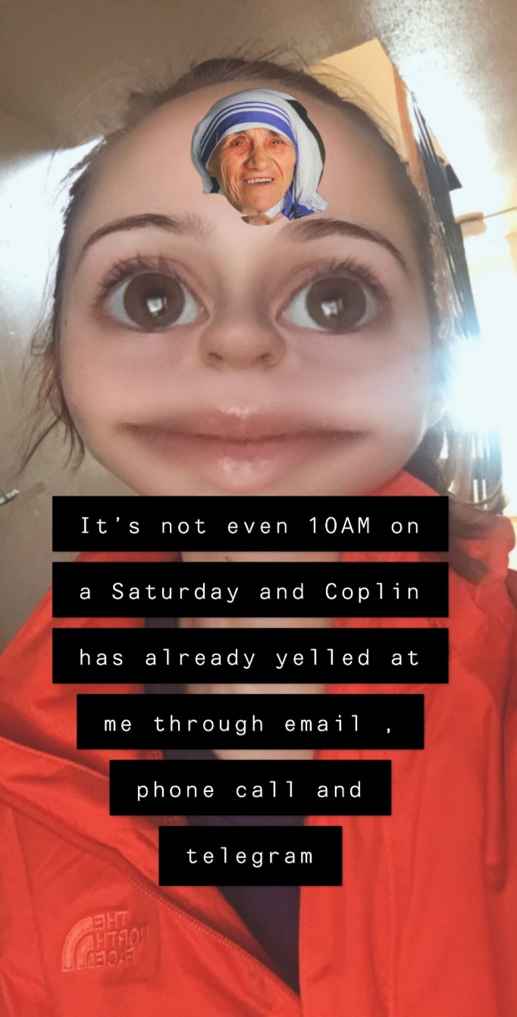
WHAT I DID IN COLLEGE
PAF 101 TA (Module 1)
TA for Kelsey’s Class (PAF 270??)
Skillz for Success Henninger HS Program
TFA Operations Intern
Juvare Marketing Intern
IVMF
Got yelled at by Coplin
Told Coplin to get his wife flowers
WHAT YOU SHOULD DO (IF YOU WANT A JOB)
Listen to Coplin
Learn how to Dale Carnegie people
Learn Excel
Take a class in the iSchool
Work while others are sleeping
Read the news
Go to class, party later
Spring 2018, via Snapchat

