Slide 2
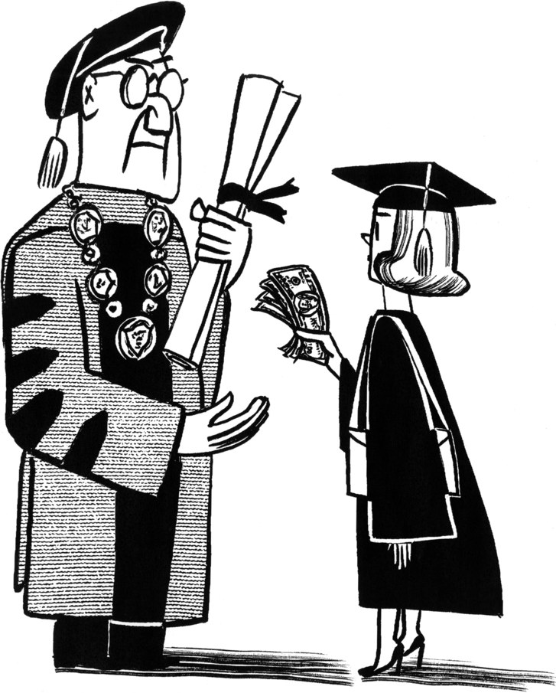
College
No College

Slide 3
Class Agenda
Announcements
Dale Carnegie
College Sucks
Assignment
Alumni Job Briefing

Slide 4
Friday Roundtable Discussions with Coplin
What is it:
A discussion group consisting of PST 101 students who enjoy thinking critically and talking about a variety of topics, including but not limited to current events and topics from lecture.
Discussion with no judgement and little to no persuasion
The goal: Try to understand different topics on a deeper level by thinking critically and building off of each other’s ideas
This is NOT for extra credit but is meant for enjoyment
When is it:
Every Friday from 2:00 - 3:00 PM over Zoom
Please contact Mary Skuthan at muskutha@syr.edu and CC your TA if you are interested in participating or have any questions

Slide 5
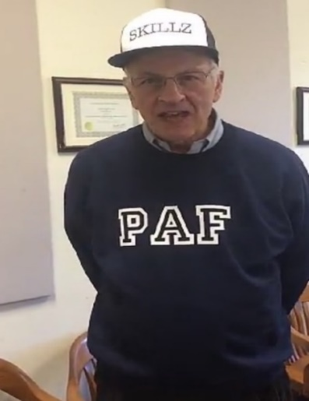
Competition Points
Groups | Points
2 | 5
8 | 4
11 | 4
13 | 4
14 | 3
9 | 2
10 | 2
12 | 2
15 | 2
17 | 2
1 | 1
4 | 1
5 | 1
16 | 1
3 | 0
6 | 0
7 | 0
Winners
Losers
As of 09/16/2020

Slide 6
Dale Carnegie Fireside Chat
With… Karina

Slide 7
Dale Carnegie Principles
Don't criticize, condemn or complain.
Give honest and sincere appreciation.
Arouse in the other person an eager want.
Become genuinely interested in other people.
Remember that a man's name is to him the sweetest and most important sound in any language.
Be a good listener. Encourage others to talk about themselves.
Talk in the terms of the other man’s interest.
Make the other person feel important and do it sincerely.
Avoid arguments.
Never tell someone they are wrong
If you're wrong, admit it quickly and emphatically.
Begin in a friendly way.
Start with questions the other person will answer yes to. Let the other person do the talking.
Let the other person feel the idea is his/hers.
Try honestly to see things from the other person's point of view.
Sympathize with the other person.
Appeal to noble motives.
Dramatize your ideas.
Throw down a challenge.
Begin with praise and honest appreciation.
Call attention to other people's mistakes indirectly.
Talk about your own mistakes first.
Ask questions instead of giving direct orders.
Let the other person save face.
Praise every improvement.
Give them a fine reputation to live up to
Encourage them by making their faults seem easy to correct.
Make the other person happy about doing what you suggest.

Slide 9
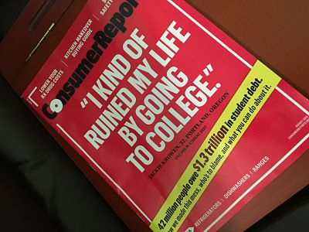

Slide 10
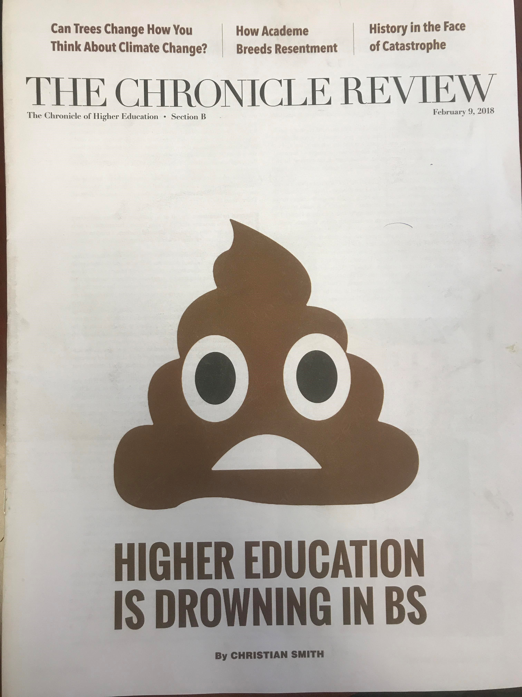

Slide 11
A Disgusting Thought
“Undergraduate business programs are anti-intellectual in an institution whose purpose is intellectual.”
Johann N Neem, Historian
The Chronicle Review, 9/6/2019, p. B14

Slide 12
UNDERLYING CAUSE
ELITISM
The faculty is the nobility and the students are the serfs
Notes:
Say: WE’RE LIVING IN THE MIDDLE AGES!!!!!!!!

Slide 13
The Study of the Study
What professors want to do to you
May not be what you want to learn
Notes:
Mention Chaucer, The Student Prince .

Slide 14
It’s Not Just the Curriculum
It’s the power relationship between faculty and undergraduates
Notes:
Students are stakeholders and faculty are the players.

Slide 15
Paulo Freire, Pedagogy of the Oppressed
“Education has become an act of depositing.”
Students are treated as receptacles and not human beings

Slide 16
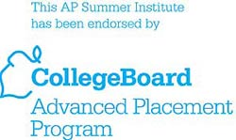
College Board Study
Study entitled Education Pays 2016 states, “both individuals and society as a whole benefit from increased levels of education.”
What is the College Board?
Notes:
501c3 whose executives are paid well and who brings you the PSAT, SAT, GRE and AP
Founded in 1900, it reaches out to more than 7 million students, 23,000 high schools and approximately 3,800 colleges.

Slide 17
More on the College Board
In 2017, the current President of College Board, David Coleman, earned $1,566,667!
Total Revenue in 2017 = $1,067,701,847 (that’s billion with a b!)
Total Expenses in 2017 = $927,784,350
Total “profit” = $139,917,497 (nearly $140 million)
SOURCE: https://projects.propublica.org/nonprofits/organizations/131623965/201823129349301967/IRS990

Slide 18
Despite the propaganda
There is both good news and bad news about higher education
This is true of all BS even as it turns you into an unwilling cash cow

Slide 19
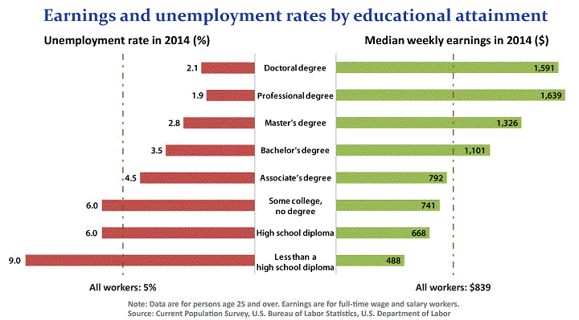
Good News
Education Pays
Notes:
Note: Show this and suggest that it seems to be pretty clear cut.
The typical bachelor’s degree recipient can expect to earn about 61 percent more over a 40-year working life than the typical high school graduate earns over the same period.
College graduates. are more likely to have pensions
Source:http://www.bls.gov/emp/ep_chart_001.htm/
http://www.bls.gov/careeroutlook/2014/data-on-display/education-still-pays.htm (for 2014 data)

Slide 20
Good News for Society
Higher levels of volunteer work, blood donations, voting
Openness to others’ opinions or it used to be
Healthier, off of welfare

Slide 21
More good news…
The 5% poverty rate in 2014 for bachelor’s degree recipients was about one-third of the 14.2% poverty rate for high school graduates.
At every age and income level, higher levels of education are correlated with better health.
Smoking rates are lower for college graduates

Slide 22
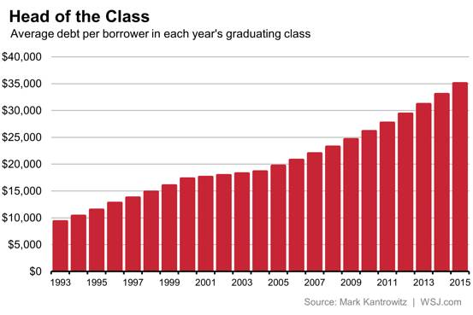
Bad News
70% of graduates have debt (2017).
Notes:
22
College loans are a $85 billion-a-year business.
New York Attorney General and loan scandals.
Source: http://amsa.com/policy/resources/stats.cfm
Source: Institute for College Access & Success' Project on Student Debt
Source for new graph: http://blogs.wsj.com/economics/2015/05/08/congratulations-class-of-2015-youre-the-most-indebted-ever-for-now/

Slide 23
Average Debt of the 70% for 2018 Graduates
$29,200- 2% more than 2017
Institute for College Access and Success (2019) reported in USA Today. 9/20/2019

Slide 24
Student Debt Owed by 50+ year olds
$86 Billion owed 50-64
Average of $33,000
Wall Street Journal 2/2/19, page B1
More than 1 trillion $ in debt for the U.S

Slide 25
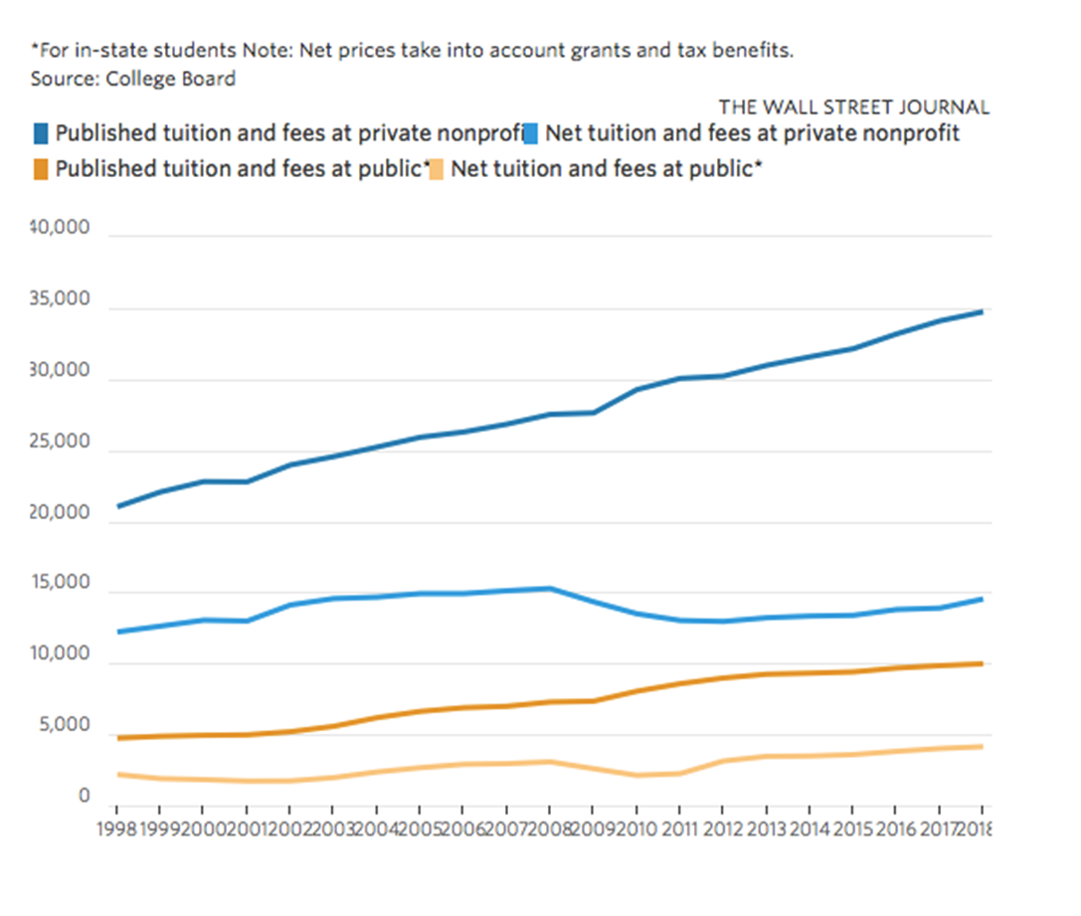
Average Tuition from 1998-2018
https://www.wsj.com/articles/college-costs-continue-to-edge-higher-1508904060
Notes:
Fed subsidies is highly correlated with the increase in tuition
Source: US News
From 2005 to 2012, average student loan debt has jumped 35%, adjusting for inflation. (Wall Street Journal)

Slide 26
College As An Investment
41% of students graduate in four years and 59% in six years.
Worse than the worst high schools in the US
It might make more sense to put money in a mutual fund.
College is risky especially as the price goes up.
$50,000 in debt means $500 a MONTH for 10 Years
Notes:
It is not clear that a college education is the best choice when considering only 35% of students graduate in 4 years.

Slide 27
Return on Investment (ROI)
SU does have a pretty good average ROI (+$368,000 over 20 years) but that’s the aggregate for all majors.
https://public.tableau.com/profile/dallin8725?fbclid=IwAR1rPeW1IGVXQ2UZ4-k4_2CJsRRR2L7G2-mBuBOaoSLZBaP7PFrlJHtAfWY#!/vizhome/CollegeReturnonInvestment_0/CollegeReturnonInvestment

Slide 28
Lack of Job Preparation
Bad News
Colleges may do very little to prepare students to be constructive citizens of society.
64% of (employed) college graduates say that they have the skills to advance in their company (Hart Research Associates, 2014).
64% of employers say that college graduates do not have the skills to advance in their company. (Hart Research Associates, 2014).
Notes:
http://www.aacu.org/sites/default/files/files/LEAP/2015employerstudentsurvey.pdf, p. 10; yes 64% is the number for both

Slide 29
Students think they are more prepared than employers do
Notes:
Hart Research Associates, 2014; Stats from previous slide

Slide 30
The WORST OF ALL
“American higher education has become a powerful means for perpetuating class divisions across generations.”
Richard V. Rees, “The End of Upward Mobility,” Chronicle of Higher Education, 12/8/17

Slide 31
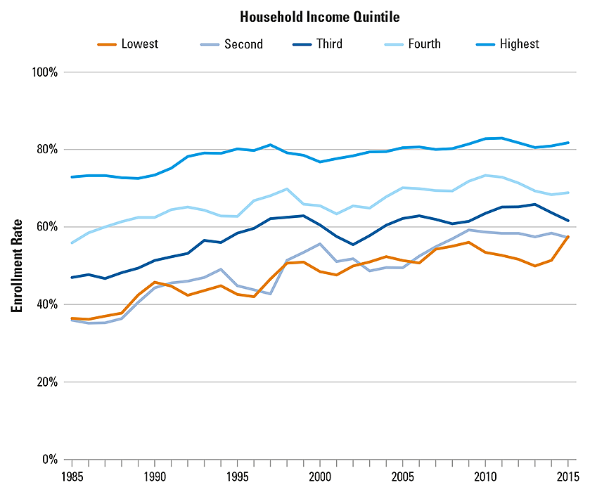
Postsecondary Enrollment Rates of Recent High School Graduates by Household Income, 1985 to 2015
SOURCE: The College Board, Education Pays 2016, Figure 1.1

Slide 32
BAs by Family income
Notes:
But poor kids go to college at a 50% rate approximately
Source: https://nces.ed.gov/programs/coe/pdf/coe_tva.pdf

Slide 33
America’s Reality
“We have set up a standard known as the B.A., stripped it of its traditional content, and made it an artificial job qualification. Then we stigmatize everyone that doesn’t get one.”
Charles Murray
Notes:
Run out of a speaking engagement at Middlebury

Slide 34
How Many 25 & Older Have Bachelors Degrees (2017)
30.9%
Source: http://www.census.gov/quickfacts/table/PST045215/0
Notes:
SOURCE: http://www.census.gov/quickfacts/table/PST045215/00

Slide 35
Protection Against the Evils of College?
What’s the vaccine if you go to college?

Slide 36
Reduce the Riskiness of College
A College Degree + X = Career Success

Slide 37
Enough About You
What does it mean for America?
$1.6 Trillion Dollars in Personal Debt
Is subsidizing college good public policy like the College Board claims?

Slide 38
A Public Policy Investment
Does it create economic growth?
How much personal and public debt does it increase?
What does college do for SOCIAL MOBILITY?
Or is it a policy to subsidize four years of a very expensive camp
Notes:
It is not clear that a college education is the best choice when considering only 35% of students graduate in 4 years.

Slide 39
Possible Public Policies
Government subsidies only for careers where there is a shortage of workers
Require 30 academic credit hours of experiential credit
Follow Ben Franklin and make a course in gardening a degree requirement

Slide 40
Propaganda Machine
“Education is a weapon, whose effect depends on who holds it in his hands and at whom it is aimed.”
Who said this?
Notes:
Joseph Stalin

Slide 41
For next class
Should have read Chapters 2, 3, and 4 by Monday 9/21 (if you’re a winner)
Don’t pack up, alumni speaker
Notes:
Slide 28

Slide 42
Tom Dannan
B.A., Policy Studies (’06)
Masters of Public Affairs (‘12)
Manager, R3 Government Solutions
tdannan@r3consulting.com Connect with me on LinkedIn!
Career Snapshot
Graduated May 2006
Newhouse dropout
Maxwell D.C. Semester (Spring ‘06)
Peace Corps Volunteer (Morocco, ‘07-’09)
Exec. Director, John Dau Foundation (‘09-’12)
Back to Syracuse for my MPA (2011-2012)
Federal government (consultant/contractor):
Department of Health and Human Services (‘12-‘14)
Department of Homeland Security (’14-‘ 15)
Department of Health and Human Services (‘15-‘20)
Department of Education (March 2020-present)
Also co-own a small business with my wife!

