Slide 1
“We can do no great things, only small things with great love.”
~Mother Teresa

Slide 2
Agenda
Announcements
Speaker: Tori Shires
Next Class

Slide 4
DPS Reform Feedback Group
Attend 1 session to share your thoughts on what DPS can improve on
Topics Covered: Bias, Expectations for Covid-19, Policy Enforcement, and Recommendations
September 16-18 Via Zoom at 3-4pm, 4-5pm, or 5-6pm
Email Kailee Vick at knvick@syr.edu or Skylar Swart at saswart@syr.edu with questions
To sign up: https://forms.gle/acbyZpFkVknhqYnB6

Slide 5
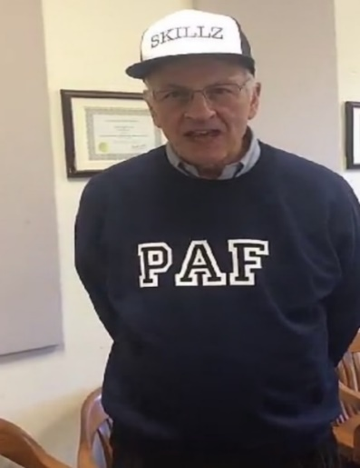
Competition Points
Groups | Points
2 | 5
11 | 4
13 | 3
8 | 2
9 | 2
10 | 2
14 | 2
1 | 1
5 | 1
15 | 1
16 | 1
17 | 1
3 | 0
4 | 0
6 | 0
7 | 0
12 | 0
Winners
Losers
As of 09/14/2020
Groups 4, 8, 12, 13, 15, 17 got a point from asking Tori questions

Slide 6
Speaker Surveys
After each speaker there will be a link in the PowerPoint to a survey
You must fill out the survey before 12:45pm on the date of the next class or lose 5 points
For any questions or concerns regarding speaker surveys please email Alexandra Whitcomb at awhitcom@syr.edu

Slide 7
Speaker Presentation
Be a good listener and questioner!
Raise your hand to ask a question
Good questions will get you 1 point for your group, especially if you give Tori a hard time.

Slide 8

Tori Shires
Graduate of Syracuse University
Chief Development Officer at
Syracuse Rescue Mission
Focus: POVERTY

Slide 9

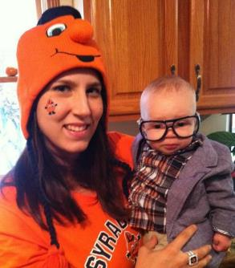


About Me
Tori Shires
Hometown: Waterbury, CT
SU Class of 2004
B.A., Policy Studies/Political Science
Love Syracuse.
Everything about it.

Slide 10

Leading Causes of Homelessness in America
Lack of affordable housing
Unemployment
Poverty
Low Wages
Mental illness and lack of needed services
Substance abuse and lack of needed services
Criminal Records
Domestic Violence/Family Stabilization

Slide 11
The Reality of Homelessness in CNY
PIT Count
national, annual census of the homeless population
occurs every January
Flawed system?
Central New York PIT stats in 2020*:
Sheltered/Unsheltered Households (at least one adult and child): 47
  Total persons: 136 (including 80 children)
Sheltered/Unsheltered Adults (no children): 475
  322 male, 151 female
Sheltered/Unsheltered Unaccompanied Youth: 7 (all female)
Adults with a serious mental illness: 182 (34% all adults)
Adults with a substance abuse disorder: 133 (25% all adults)
Adult survivors of domestic violence: 90 (17% all adults)
Veterans: 30 (6% all adults, all male)
*includes Onondaga, Cayuga, Cortland, Oswego counties

Slide 12
Digging Deeper: Racial Disparities
According to US Census data (2019), in Onondaga County:
80% of the population is White
12% of the population is Black
According to the 2018 PIT Count, in Onondaga County:
39.5% of the homeless population is White
47.9% of the homeless population is Black

Slide 13
Additional Resources on Homelessness
Evicted: Poverty and Profit in the American City
  Author: Matthew Desmond
NY Times The Daily Podcast, “The Sunday Read: The Children in the Shadows”, 9/13/20
2017 C4 Innovations SPARC Study:
  Chose six communities: Atlanta, Dallas, San Francisco; Syracuse, NY; Columbus, OH; Pierce County, WA
  Studied racial disparities in homelessness

Slide 14


Slide 15


Slide 16

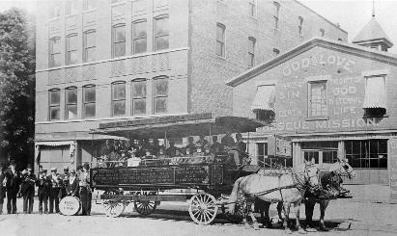

Slide 17


Serving Three Regions in New York State

Slide 18

2019 RESCUE MISSION IMPACT
211,648 meals served
104,482 overnight stays provided
569 permanent housing placements
176 found employment
9,655 men, women and children served

Slide 19
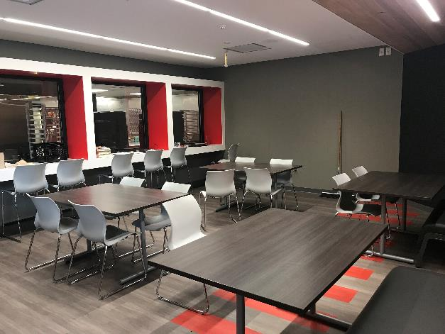
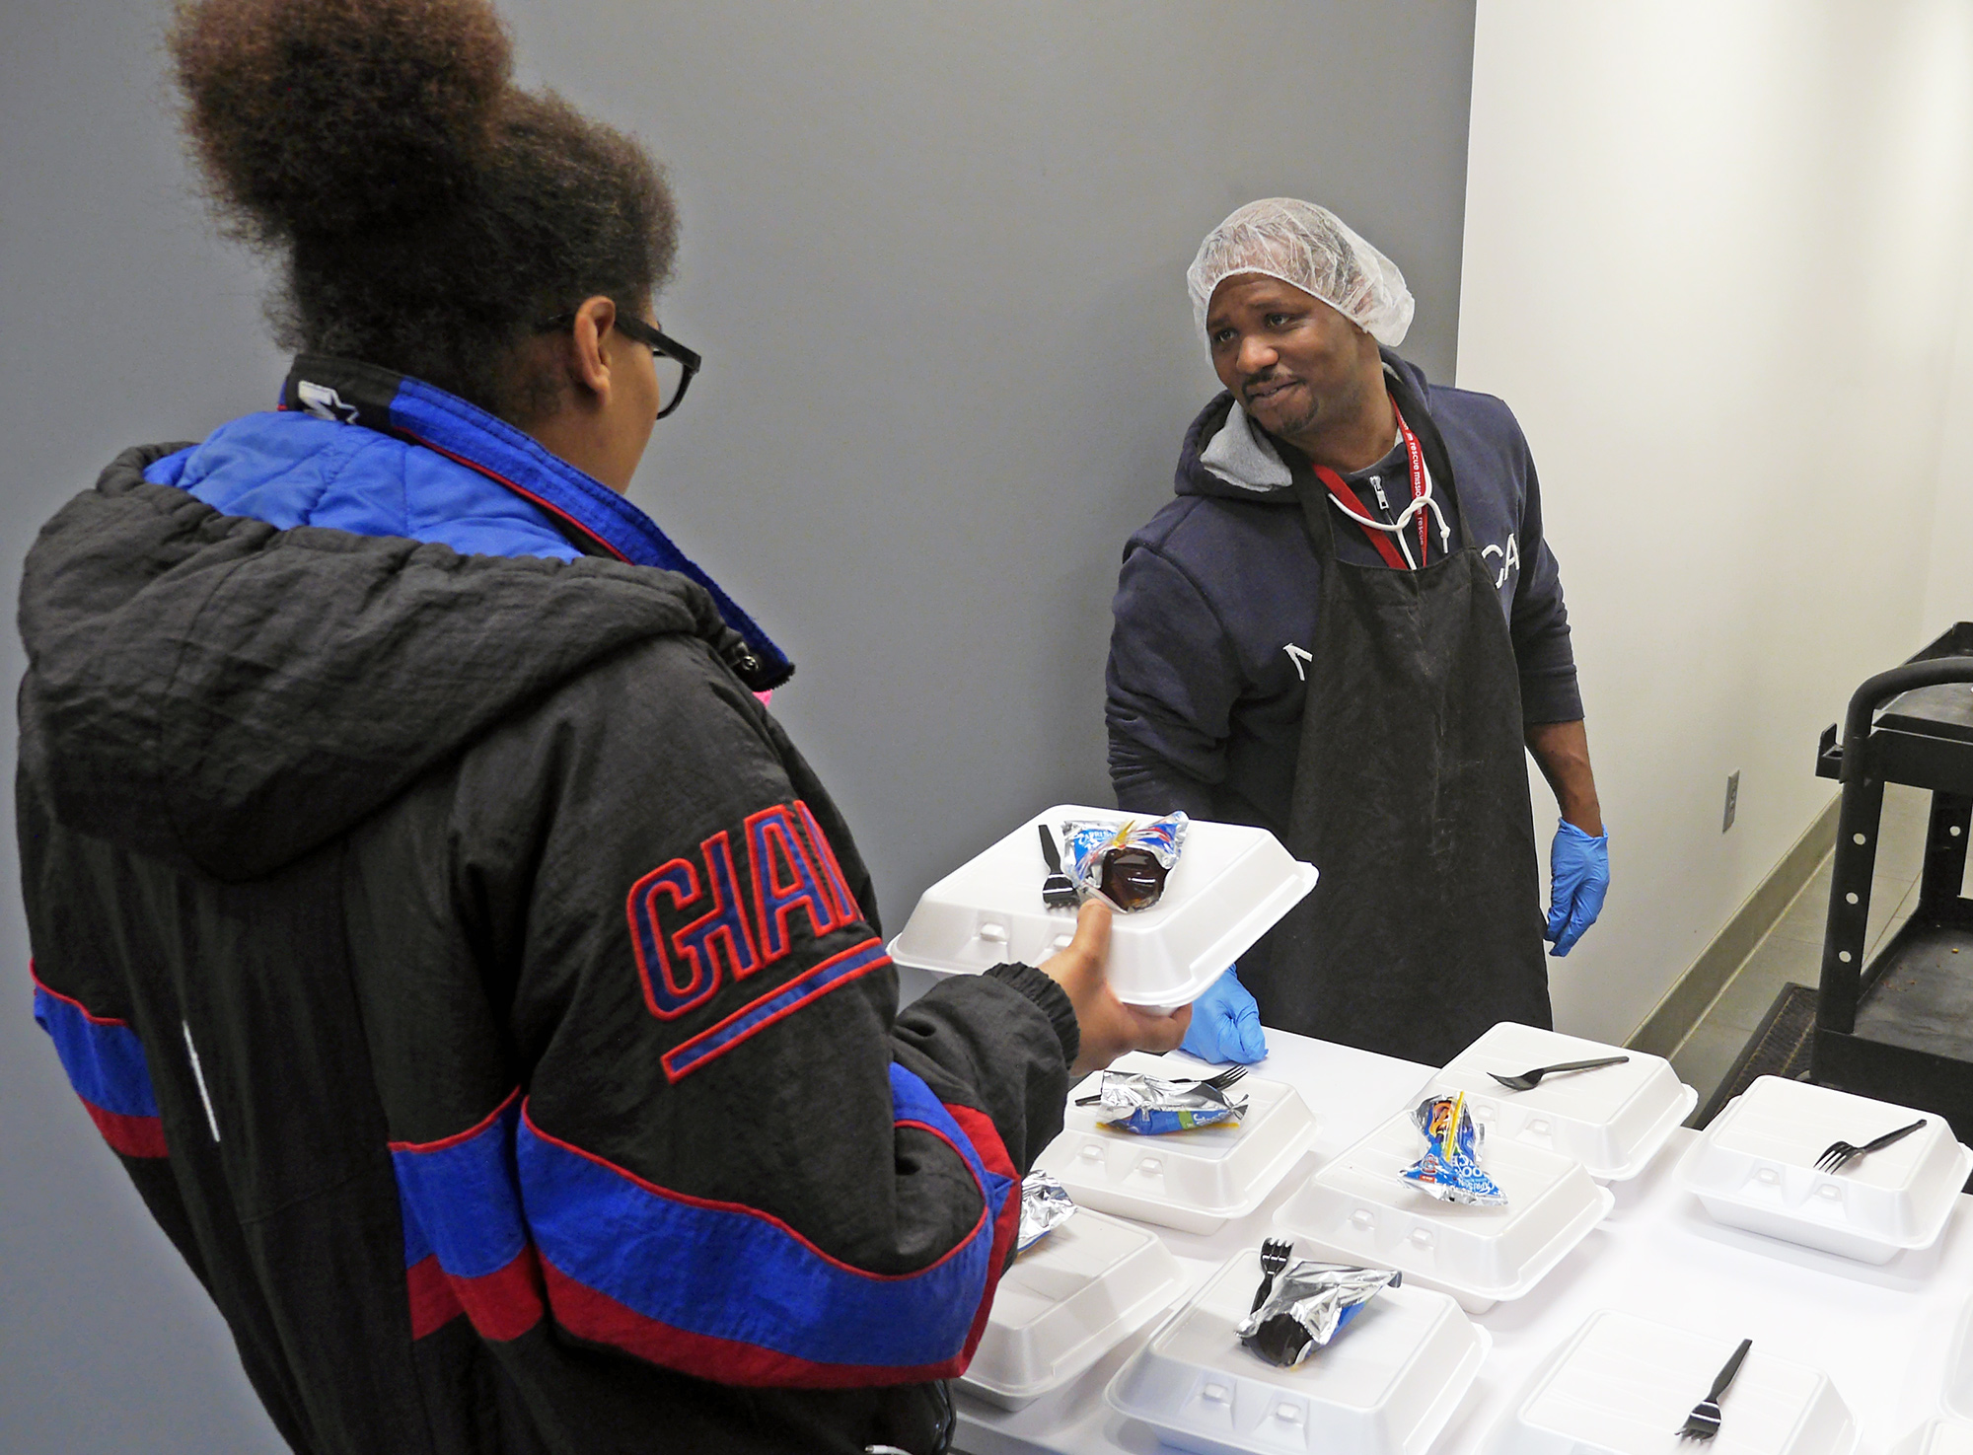
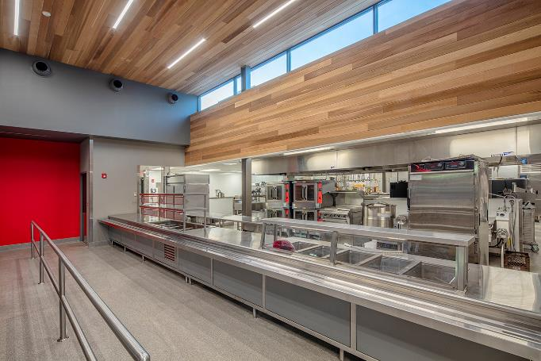
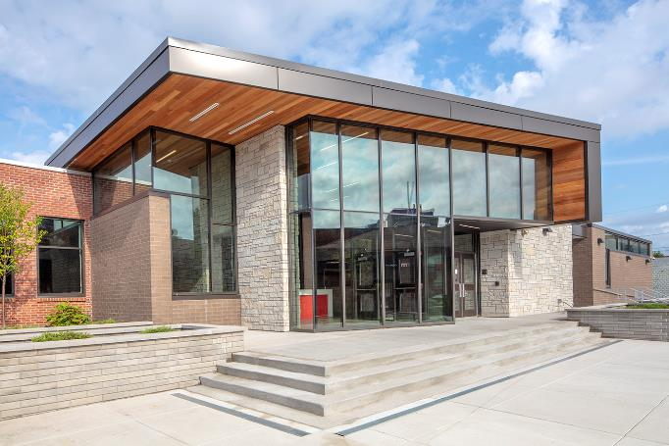
Food Services Center: 3 Meals/Day, 365 Days/Year

Slide 20
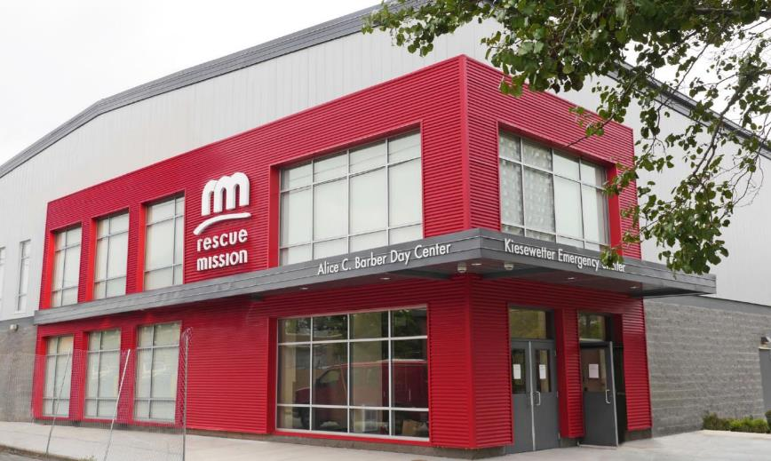
Emergency Shelter and Day Center

Slide 21
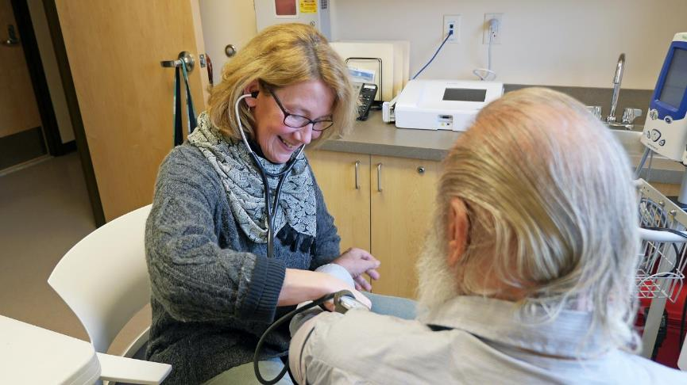
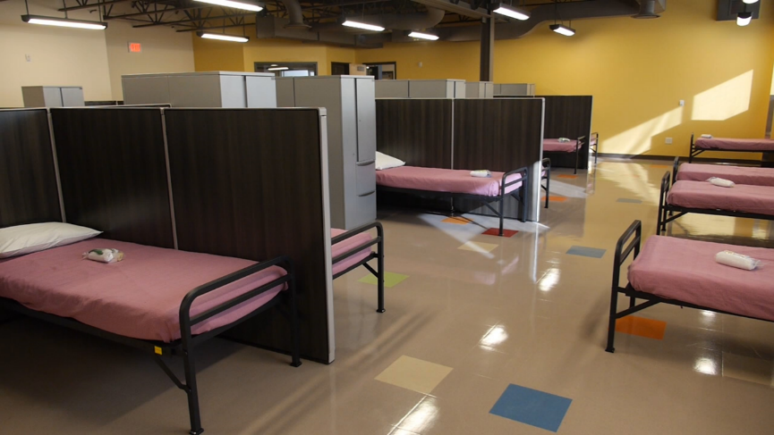
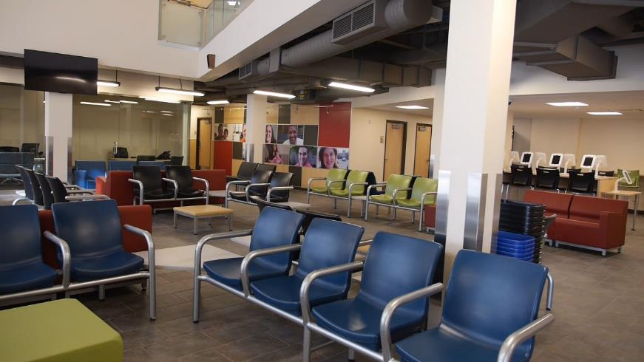
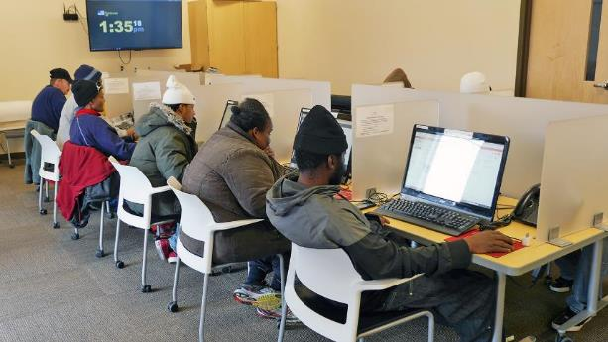

Slide 22
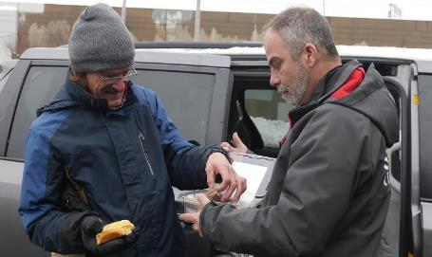
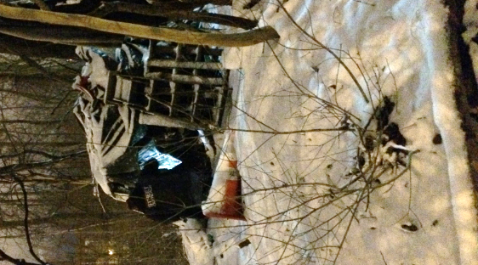
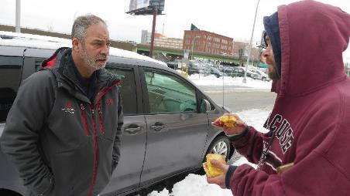
Street Outreach

Slide 23
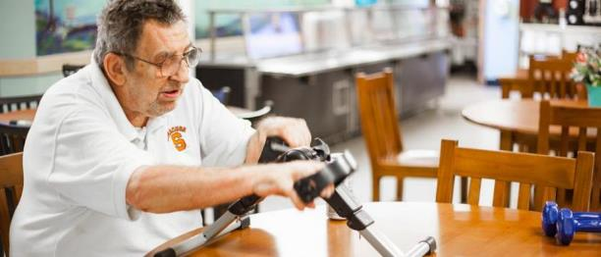
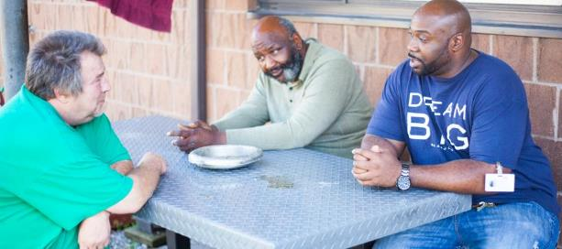
Crossroads Adult Home

Slide 24

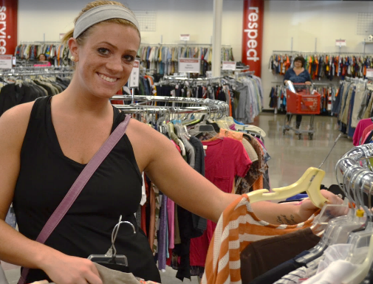

Thrifty Shoppers and 3fifteen

Slide 25


Slide 26

Rescue Mission and the Coronavirus
How has COVID-19 impacted Rescue Mission Operations?
Changes in programming
  Food Service
  Shelter
  Permanent Housing
Financial Ramifications
Personnel Ramifcations

Slide 27
Doing Well
to
Doing Good

Slide 28
Questions?
Tori Shires
Chief Development Officer
victoria.shires@rmsyr.org
315.877.7876
www.rescuemissionalliance.org

Slide 29
For Next Class
Fill out Tori’s speaker survey by 12:45PM on Friday 9/18 or lose 5 points
  Link:https://syracuseuniversity.qualtrics.com/jfe/form/SV_8dDrcqxBzBGkS69

