Slide 1
Agenda
Announcements
Speaker: Deka Dancil
Next Class

Slide 2
Responsible Chat Behavior
Ask questions that you would like Coplin or speaker to answer
Do not clutter it with your thoughts and feelings
Your TA will be watching for inappropriate behavior, which is the same as poor participation (-5 points)
Keep questions relevant
Raising hand increases probability of getting called on

Slide 3
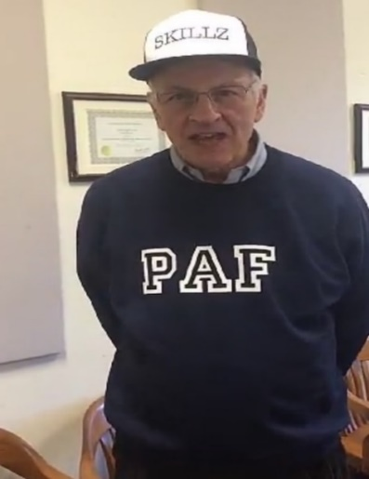
Competition Points
Groups | Points
2 | 4
11 | 3
8 | 2
1 | 1
9 | 1
10 | 1
12 | 1
13 | 1
17 | 1
3 | 0
4 | 0
5 | 0
6 | 0
7 | 0
14 | 0
15 | 0
16 | 0
Winners
Losers
As of 09/11/2020
Groups 2, 5, 10, 13, 14, 15, 16 got a point today for all turning in a question (next class slide)

Slide 4
Speaker Surveys
After each speaker there will be a link in the PowerPoint to a survey
You must fill out the survey before 11:00 am on the date of the next class or lose 5 points
For any questions or concerns regarding speaker surveys please email Alexandra Whitcomb at awhitcom@syr.edu

Slide 5
Speaker Presentation
Be a good listener and questioner!
Raise your hand to ask a question
Good questions will get 1 point for your group, especially if you give Deka a hard time.

Slide 6
Deka Dancil
Graduate of Syracuse University
Works at Syracuse University in the
Department of Inclusion, Communication,
and Citizenship
Focus: POVERTY

Slide 7
About Deka
‘Cuse class of 2014 and I #BleedOrange, PERIODT!
Mother
Community advocate – President of Urban Jobs Task Force
Manager of Bias Response & Education at Syracuse University
Co-founder of Rise Up for Social Action – Diversity, Equity, and Inclusion consultant

Slide 8
Poverty in Syracuse – the Facts
# 1 in concentrated poverty for Blacks and Hispanics in the nation – median white household earns nearly double of median income for non-white households
18th poorest city in the nation
9th most segregated county in country
In 2018, 30.5% of Syracusans lived in Poverty
44% of children in Syracuse lived in poverty in 2018
In 2017, for college graduates with a bachelor’s degree or higher, the poverty rate was 13.1%. For black college grads, the poverty rate was 39%.
In 2017, nearly 18% of households in Syracuse had an annual income of $10,000 or less

Slide 9
How did we get there?
Redlining
Urban Renewal
I-81
Loss of factory jobs
New jobs created since 2008
Structural Violence in general
COVID-19

Slide 10
A Snapple Fact
“For every 100 people born into poverty in the United States only 4 will make it to the upper-middle class.”
“For every 100 people born into poverty in the United States only 16 will make it to the middle class.”

Slide 11
Why is it SO hard to escape poverty?
Cliff effect
Severely underfunded and inadequate public education
It’s expensive to be poor!
Transportation barrier
Lack of affordable housing
Lack of affordable childcare options
Lack of opportunity

Slide 12
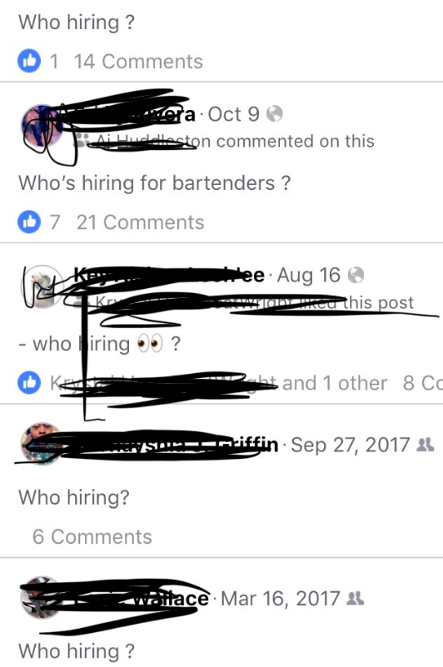
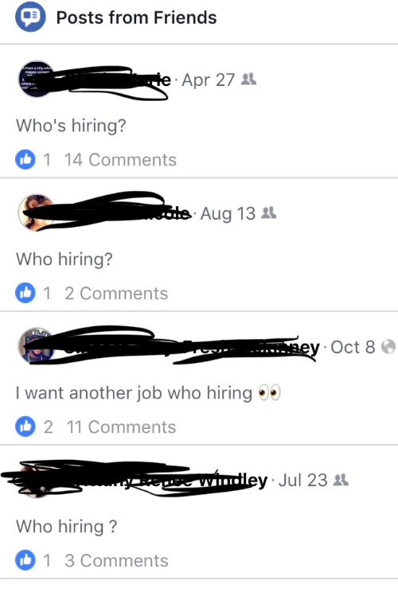
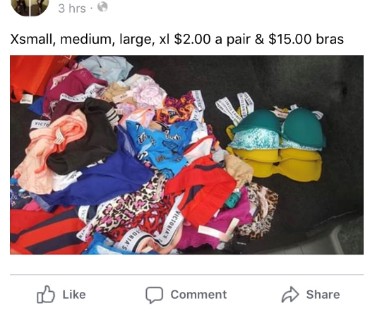
What does this look like in real life?

Slide 13
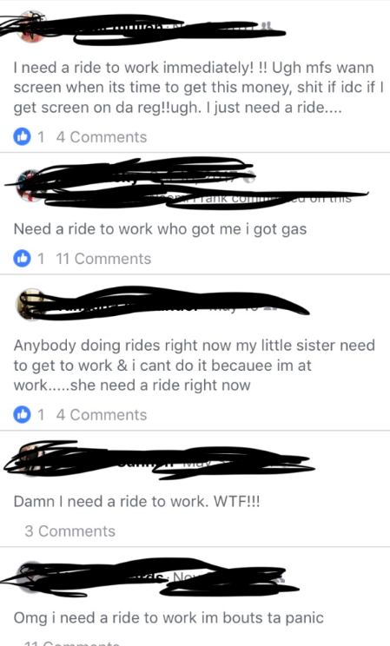
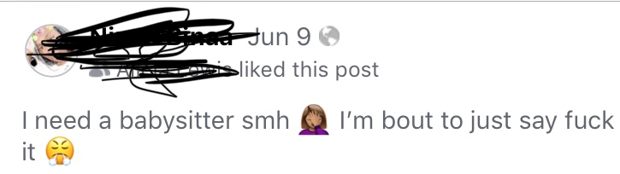
What does this look like in real life?

Slide 14
What does this look like in real life?

Slide 15
Why Should this Matter to Policy Studies Majors?
Inequality in our country has been created through policy
Structural Violence
You are future policy makers

Slide 16
Humane Obligation for Future “Do-gooders”
Simply believing in inequality and having good intentions is not enough
Empathy, not sympathy
Respect the experience of, value, & uplift credible messengers
Don’t be a band-aider - always look for the why

Slide 17
Organizations Doing Good in Syracuse
Boys & Girls Clubs
Rescue Mission
PEACE, Inc.
Rise Above Poverty
Legal Services of CNY
CNY Diaper Bank
Samaritan Center

Slide 18
Doing Good & Well @ SU
Recognize
Report
STOP
For more information on bias and bias-related incident response on campus or to submit a report visit www.stopbias.syr.edu
Deka Dancil – Manager, Bias Response & Education
(315) 443-3514 stopbias@syr.edu

Slide 19
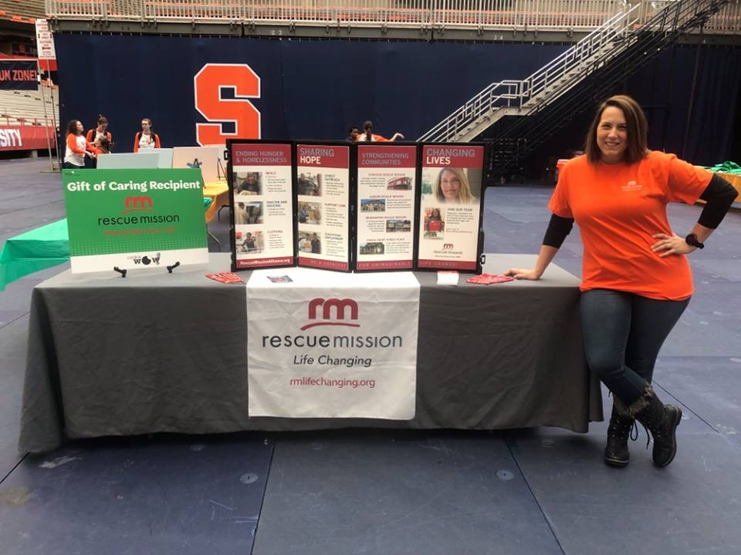
Tori Shires
Tori Shires
Graduate of Syracuse University
Chief Development Officer at Syracuse Rescue Mission
Focus: POVERTY

Slide 20
Extra Credit Opportunity
Email your TA a question about public policy regarding poverty by 11:00 am on 9/16
If every member in your group hands in a question your group will earn 1 extra credit point.

Slide 21
Module Regrade Instructions
If you believe a TA made a mistake grading your module, you can submit a regrade to potentially receive points back
This is not an opportunity for you to fix your mistakes!
Regrade templates with examples are available under “Information” → “Resources”
Copy the template directly into the body of the email.
Email your completed regrade template AND your graded module to Sarah Morin at smorin@syr.edu

Slide 22
For Next Class
Fill out Deka’s speaker survey by 12:45 PM on Wednesday 9/16 or lose 5 points
Link:https://syracuseuniversity.qualtrics.com/jfe/form/SV_3dQJrOdU84gbnuJ
Email your TA a question for Tori by 11:00 am on Wednesday 9/16 and come prepared to ask it
Submit Regrade Template and graded Module 1 paper attached in an email to Sarah Morin at smorin@syr.edu no later than 12:45 on Wednesday 9/16

