Slide 1
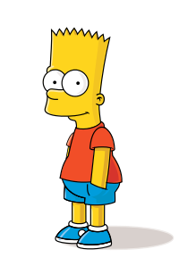
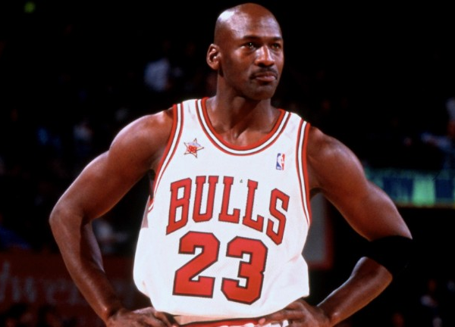
Where are you on the Bart Simpson—
Michael Jordan Continuum?
Bart Simpson
Michael Jordan

Slide 2
Class Agenda
Announcements
Intro to Mod 2
Dale Carnegie
Two quotes that you need
Assignment for Next Class

Slide 3
Better Grades Through Extra Credit
Total Points from Modules: 650
Extra Credit Options – up to 55 extra credit points
Pay attention to the options in the next slides

Slide 4
TedTalks
Receive extra credit throughout the semester by watching the posted TedTalks for each Module, beginning with Module 2.
You may receive up to 3 points per TedTalk you watch and complete questions for:
5 total TedTalks x 3 points TedTalk = 15 possible points

Slide 5
How extra credit works!
TedTalk Link:
https://www.ted.com/talks/thomas_abt_why_violence_clusters_in_cities_and_how_to_reduce_it DUE 9/25 AT 8 PM
Survey Link:https://syracuseuniversity.qualtrics.com/jfe/form/SV_9Y5UxMwIxBnRE3P
Complete the online form on Blackboard located under the Extra Credit tab
If you have questions email Brinn (brmacrae@syr.edu)
If you do not receive an email within 24 hours, please contact Brinn at brmacrae@syr.edu to ensure that you get points!

Slide 6
Dale Carnegie Speeches
Record a video of your Dale Carnegie Speech and send to Brinn (brmacrae@syr.edu)
You can only do this one time during the semester, for a maximum of 3 extra credit points
Within 24 hours of your submission, Brinn will email you letting you know she received it and how many points you earned
Your speech should follow this outline:
State the situation and the problem
Explain what you did
Explain the benefit to you
Identify the Dale Carnegie principle used
Be under 2 minutes!

Slide 7
Excel Certification: 10 points
Certifications are due by submitting the Excel form under the extra credit tab by 9pm on 11/20
If you are already Excel certified, you can still receive 5 extra credit points
For more information on getting certified and GMetrix use this link:
http://ict.syr.edu/training/maxwell-testing-center/
For any questions regarding the Excel Certification process: Email Maya Padula mcpadula@syr.edu

Slide 8
Friday Roundtable Discussions with Coplin
What is it:
A discussion group consisting of PST 101 students who enjoy thinking critically and talking about a variety of topics, including but not limited to current events and topics from lecture.
Discussion with no judgement and little to no persuasion
The goal: Try to understand different topics on a deeper level by thinking critically and building off of each other’s ideas
This is NOT for extra credit but is meant for enjoyment
When is it:
Every Friday (starting 9/11) from 2:00 - 3:00 PM over Zoom
Please contact Mary Skuthan at muskutha@syr.edu and CC your TA if you are interested in participating or have any questions

Slide 9
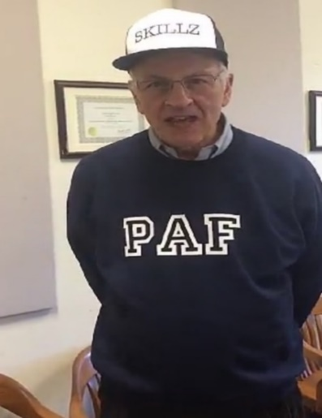
Competition Points
Groups | Points
2 | 3
1 | 1
10 | 1
11 | 1
12 | 1
17 | 1
3 | 0
4 | 0
5 | 0
6 | 0
7 | 0
8 | 0
9 | 0
13 | 0
14 | 0
15 | 0
16 | 0
Winners
Losers
As of 09/5/2020

Slide 10
Module 2 Schedule
9/7- Introduction to Module 2
9/9- Library Workshop
9/11- Societal problems and policy changes
9/14- Deka Dancil
9/16- Tori Shires
9/18- College Sucks
9/21- Designing a survey lecture
9/23- Competition Workshop
9/25- Competition Debriefing
9/28- Introduction to Module 3

Slide 11
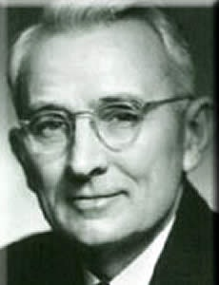
Meet Dale.
Sup.
Dale Carnegie was born in Missouri and was raised by poor farmers.
By the end of his life, he had amassed a fortune and is called the founder of self-help.
His book How to Win Friends and Influence People has sold over 10 million copies.

Slide 12
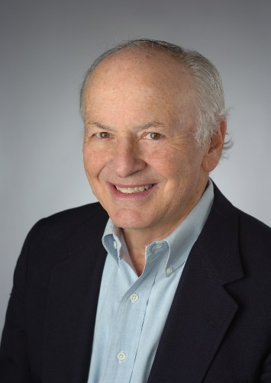
Why should YOU know him?
His principles will help you know how to successfully interact with others.
You will make more friends and fewer enemies.
Learning DC will change the way you view yourself, and in turn, help the way others view you.
DC is the path to a diverse society
His principles will allow you to succeed in life…

Slide 13
Dale Carnegie
https://www.youtube.com/watch?v=O48JaCuiH34

Slide 14
Dale Carnegie Fireside Chat
Featuring…SHEA!

Slide 15
Dale Carnegie Principles (Available on Blackboard)
Don't criticize, condemn or complain.
Give honest and sincere appreciation.
Arouse in the other person an eager want.
Become genuinely interested in other people.
Remember that a man's name is to him the sweetest and most important sound in any language.
Be a good listener. Encourage others to talk about themselves.
Talk in the terms of the other man’s interest.
Make the other person feel important and do it sincerely.
Avoid arguments.
Never tell someone they are wrong
If you're wrong, admit it quickly and emphatically.
Begin in a friendly way.
Start with questions the other person will answer yes to. Let the other person do the talking.
Let the other person feel the idea is his/hers.
Try honestly to see things from the other person's point of view.
Sympathize with the other person.
Appeal to noble motives.
Dramatize your ideas.
Throw down a challenge.
Begin with praise and honest appreciation.
Call attention to other people's mistakes indirectly.
Talk about your own mistakes first.
Ask questions instead of giving direct orders.
Let the other person save face.
Praise every improvement.
Give them a fine reputation to live up to
Encourage them by making their faults seem easy to correct.
Make the other person happy about doing what you suggest.

Slide 16
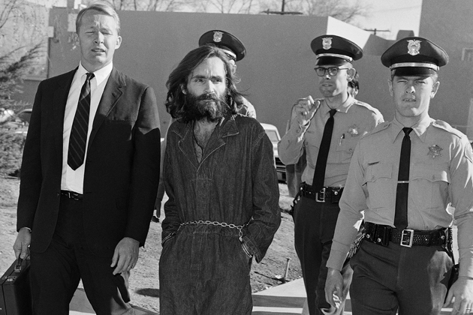
Famous DC Users http://www.bloomberg.com/bw/articles/2013-07-22/charles-mansons-turning-point-dale-carnegie-classes
Dale Carnegie Training shaped the lives of such people as Warren Buffett, Johnny Cash, Emeril Lagasse, and Charles Manson.

Slide 17
What is Dale Carnegie?
It depends
A tool
A way of life
Good BS

Slide 18
Introduction to Module Two
Exercises for Chapters 2-4
One of Seven Topic Areas from Module 1
☑
Not Too Specific
☒
Notes:
Take notes-remember that exercise 1.4 is good for the topic for Module 2.

Slide 19
Introduction to Module Two
Chapter 2: Use the library
Chapter 3: Find players to interview
Chapter 4: Design a survey on a societal problem or policy in a specified geographic area

Slide 20
Two Famous Coplin Quotes
Remember them for the rest of your life!!

Slide 21
Quote #1
“Life is an aggregation problem.”

Slide 22
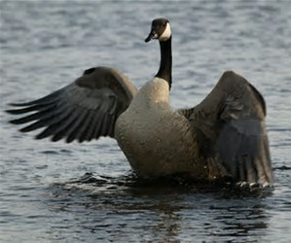
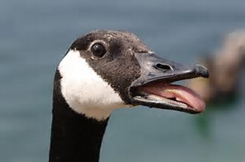
Dealing with “Life is an Aggregation Problem”
Canada Goose–
a beautiful bird
versus
a flying crap machine
Notes:
Notes Who can give me an example?
Compare Liberal Arts from the brochures and the words of the Dean to your actual experiences.
Public Policy Analysts must talk to stakeholders, players, and experts.

Slide 23
When you can take a 3 page paper and:
Reduce it to 1 page
Reduce that to 3 paragraphs
Reduce that to 1 paragraph
Reduce that to 1 sentence
You will understand that life is an aggregation problem.
Notes:
Trump has proven the power of tweets which is an extreme form of aggregation

Slide 24
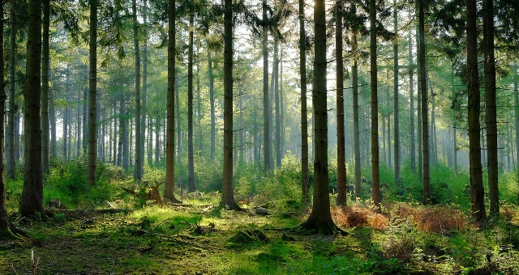
Be Both Kinds of a Person
Correctly decide when to be:
A Tree Person -disaggregated
A Forest Person –aggregated
Tree Person
Forest Person
Notes:
Apply to 101—Ann and Jim are failing versus the class is doing poorly

Slide 25
Life is an Aggregation Problem for You in PST 101
Your answers have to be not too general and not too specific
Notes:
What will the TA consider the right amount of detail

Slide 26
The Problem with Generalizations
Very difficult because “to generalize is to be an idiot.” -Wm. Blake, 18th century poet
Which leads to the second quote

Slide 27
Quote #2 #2 Most Important Quote
“EVERYTHING IS B.S.”
All statements are speculation for a purpose.
Some statements are closer to the truth but we can never be sure.
This is reality; learn to deal with it.
Notes:
Hint: Ask yourself why do cows defecate and what are the consequences?

Slide 28
Example: The Magna Carta
QUOTATION OF THE DAY "The myth of Magna Carta lies at the whole origin of our perception of who we are as an English-speaking people, freedom-loving people who've lived with a degree of liberty and under a rule of law for 800 years. It's a load of tripe, of course. But it's a very useful myth." NICHOLAS VINCENT, a professor at the University of East Anglia and author of a book on the document.

Slide 29
BS is
As essential to the human condition as air is to human life
Where do you find it?

Slide 30
BS in Policy Discussions
Declaration of Independence
Trickle Down Theory
Social Justice

Slide 31
BS and Truth
Truth is an ideal; not a reality
Actions are reality
BS can lead to action
Action can lead to BS

Slide 32
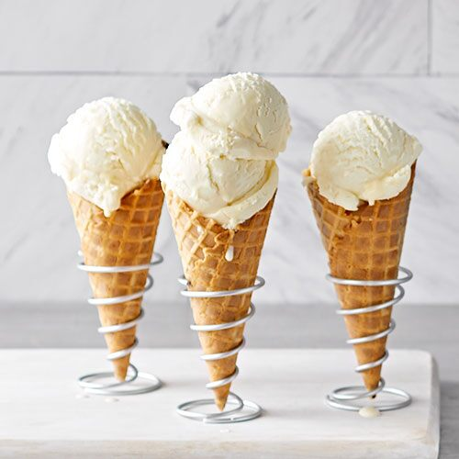
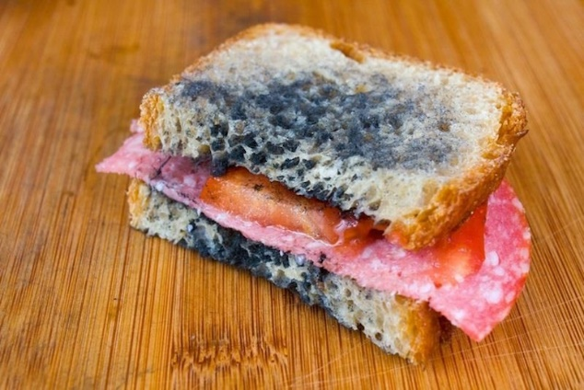
The BS Continuum
Good
Bad
Notes:
*Ask class to participate for possible competition points

Slide 33
BS is the fertilizer of life
Good
Can lead to good decision
It serves as play
It drives business-a.k.a. known as advertising
It drives do-gooders
Substitutes for war
Bad –too much:
Can lead to bad decisions
Pollutes the political atmosphere
Destroys the news media
Makes brown spots in lawns and stinks
Can lead to war

Slide 34
Antidote to BS Excesses
Avoid groupthink
Avoid cognitive dissonance
Always admit that it is speculation
Use analysis rather than rhetoric
Be a problem-solver
Be ????
Notes:
??? –pragmatic (Ask class)

Slide 35
BS restores faith to its proper place
With only speculation, actions can only be based on faith
Speculation cannot eliminate uncertainty no matter how much theory, data, logic, or smarts!

Slide 36
Free Exchange of BS is Required
“I’ve heard some college campuses where they don’t want to have a guest speaker who is too conservative or they don’t want to read a book if it has language that is offensive to African-Americans or somehow sends a demeaning signal towards women…I gotta tell you I don’t agree with that either. I don’t agree that you, when you become students at colleges, have to be coddled and protected from different points of view…You shouldn’t silence them by saying, ‘You can’t come because I’m too sensitive to hear what you have to say.’ That’s not the way we learn either.” – AUTHOR?

Slide 37
Module 1 Evaluation Survey
Survey Link: https://forms.gle/5VKmw5N2ja1MHnWR7
Be a good citizen and help us improve the course- this can only help you!

Slide 38
For next class
Read Chapter 2 and review Exercises 2.1-2.5
Review the librarian tip sheet on Blackboard
Do the survey please!
Module 2 due by 12:45 PM on Monday 9/28
Notes:
Slide 28

