Slide 1
"Failure is the mother of success.”
- Chinese Proverb
Correct
Incorrect

Slide 2
Class Agenda
Announcements
Getting an A in PST 101
Module 1 Questions and Advice
TPE Debriefing

Slide 3
Office Hours via Zoom with Coplin
Monday, Wednesday, Friday before 10:00
Tuesday and Thursday before 10:00 and 1:00-4:30
Email me to determine which day
We can talk about anything

Slide 4
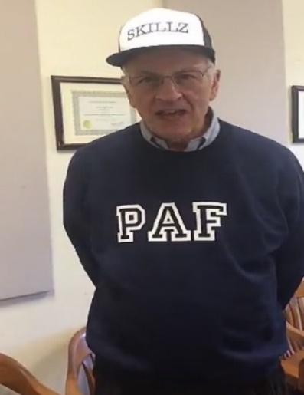
Competition Points
Groups | Points
2 | 2
1 | 1
10 | 1
11 | 1
12 | 1
17 | 1
3 | 0
4 | 0
5 | 0
6 | 0
7 | 0
8 | 0
9 | 0
13 | 0
14 | 0
15 | 0
16 | 0
Winners
Losers
As of 09/5/2020

Slide 5
Getting an A on Module 1
The only FAQs you need to know right now are to
LOOK AT THE NEWSLETTER UNDER “MODULE 1” AND THEN LOOK AT FORMATTING AND GRAMMAR GUIDELINES UNDER “RESOURCES FOR ALL”

Slide 6
Module One Questions
TA Office hours through Zoom are posted on the “TA’s” tab on Blackboard
You can go to Zoom office hours any time for help from a TA
Your TA and Coplin can’t answer any of your questions by email past 12:45pm the day before the paper is due. (You have until 12:45 tomorrow to ask questions).

Slide 7
Losing Organizational Points
Missing deadline
Not making sure pages are numbered and are in the right order
Unnecessary attachments
MUST BE A WORD DOCUMENT NOT A PDF OR ONEDRIVE

Slide 8
TPE List of Policy Proposals
17 Groups
Stricter enforcement (DPS, RAs, Room Checks) 5
Breathalyzers 4
Education for students on campus 2
Banning hard liquor/ Dry campus 2
Changing info on student Ids 1
More serious consequences 2
Businesses Change 1

Slide 9
Format and Writing 4.6 out of 5
Writing Suggestions—
Avoid long paragraphs
THE LESS INK THE BETTER (BAD “in other collegiate establishments”)
Use words correctly, not like “Our policy would improve SUs underage alcohol consumption”
Avoid adverbs like “Group X firmly and vehemently stands or “huge”....” Adjectives also suck
NEVER USE THE WORD “utilize” for the rest of your entire life. What word should you use instead?
“Plethora” is an affectation of the upper class
Semi colons (;) are rarely if ever to be used unless you are a loser

Slide 10
Example of a Wordy Sentence
“Through the examination of the recommended policy in incidents and environments, it is determined that this policy is politically acceptable and feasible.”
I fell asleep reading this one
Never use it is or there is or there are
Avoid adverbs like the plague

Slide 11
More Horrible Wordy Writing
“The goal is to create an informative, edifying dialogue between students and administrators that goes beyond ineffective online alcohol education courses, and offers solutions that suit both the University and its underage student population.”
This is elitist babble

Slide 12
Statement of Societal Problem: 4.7 Out of 5
Subject: Should be a phrase and not a sentence. This is a subject of the memo.
Good: Underage consumption of alcohol at SU is too high.
EVIL: Almost 200 words talking about stuff as one group did under subject.
EVIL: Forgetting top part of the Memo seriously?

Slide 13
Clarity of Policy: 6 Out of 10
Bad: More than one specific policy
Bad: Did not stick to the policy throughout memo
Bad: Mandatory fine (but no indication for what or how made mandatory)
Bad: Writing to a SU administrator to propose a State law in New York State
Good—Just the right amount of detail. E.g., put breathalyzers at the door of dorms
How do you know what is the right amount of detail—see next slide

Slide 14
Effectiveness: 6.4 out of 10
10 points: Justification of Effectiveness
BAD: Just restated the policy—harsher penalties will work.
Bad: “Our recommended policy will help ameliorate the societal problem because it will reduce public drunkenness and property damage.”
BAD: Off point: the policy will “foster more original thought”or “make better citizens”
Good: Come up with an explanation like “fear of being caught will deter students”
Good: Cited successful policy at another college
Good: Cited a study showing policy worked

Slide 15
Feasibility: 3.5 out of 10
Justification of Feasibility
BAD: “Likelihood is conceivable”
BAD: “This policy has a probable chance of passing.”
BAD: “The feasibility of this policy is plausible.”
BAD: “This policy is feasible because it will work.”
Good: “The policy is unlikely to be put into effect since it would cost SU money, and the Board of Trustees will be against it.”

Slide 16
Feasibility Requires Knowledge
Store owners will not check for SUID because SU tells them to.
Feasible because it uses resources that already exist.
Coordination between DPS and OSL is not easy
Always look for opposition and people who say they support but don’t

Slide 17
Effectiveness vs. Feasibility
Separate them always
What is effective is not always feasible, and what is feasible is not always effective

Slide 18
Information: 4.0 Out of 5
Looking for multiple sources

Slide 19
Internal Cite & Reference: 2.8 Out of 5
References– center and not all caps
Many, many, many, many errors.

Slide 20
Overall Score
TOTAL POSSIBLE SCORE ............ (50)
Last Class: 35.5 (Spring 2020)
This Class: 34.3

Slide 21
Just the Right Amount of Detail
Be Goldilocks
Life is an aggregation problem
It’s a judgment call
For your modules, what’s the best principle? Raise your hand!
Notes:
Write what you think the TA’s and Coplin will consider correct.

Slide 22
What You Should Have Learned About Public Policy Analysis?
Clearly define the problem
Identify causes
Develop policies aimed at the problem
Think of effectiveness in terms of ameliorating problems
Think of feasibility in terms of gaining support from powerful players

Slide 23
The TPE simulates situations
you will encounter in the
REAL WORLD

Slide 24
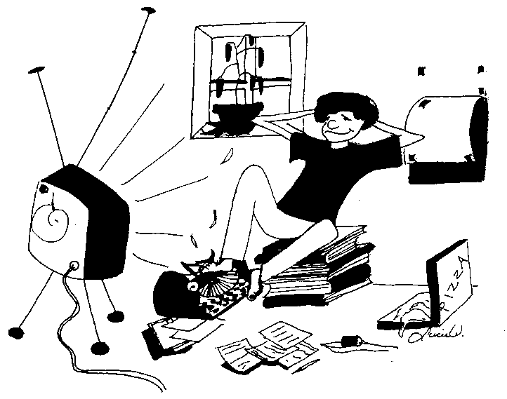
Procrastination
Notes:
-Everyone stands to end procrastination
-lead group in declaration “My name is ________ and I am a procrastinator.”

Slide 25
What are the causes of procrastination ?
Fear of failure
Fear of success
Priorities are a bitch
Thinks it is more efficient
and …
Notes:
And… (Peer pressure is next slide)

Slide 26
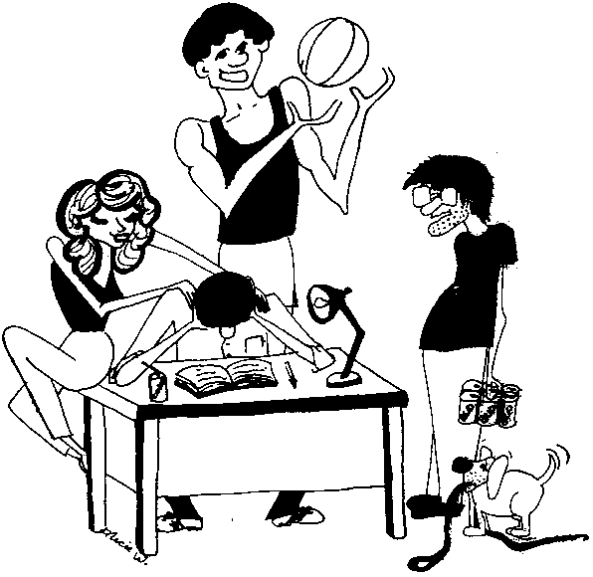
Peer Pressure is EVIL
Notes:
There is a solution to your problem

Slide 27
The Ultimate Vaccine
If your friends told you to stick your head in a bucket of $#!+, would you?

Slide 28
THE BIGGEST PIECES OF ADVICE
Follow the %#$*ing directions
Read the %#$*ing Textbook
Save %#$*ing time to edit and proof

Slide 29
Failing is necessary to success.
“For the things we have to learn before we can do them, we learn by doing them!” Aristotle
“Experience is a hard teacher because she gives the test first, the lessons afterwards.”
Vernon Saunders

Slide 30
For Next Class
Module One: emailed to your TA by 12:45PM ON MONDAY 9/7!!! NO PAPER COPIES WILL BE ACCEPTED!!! MUST BE A WORD DOCUMENT!!!
5 points will be deducted for being late to the zoom and 5 for late papers before 4:30. After 4:30 Monday- Read the late paper policy carefully.
Read through Module Two if you can get your act together enough to remember it. No penalty if you don’t except what it tells you about yourself.
Notes:
Read the directions about penalties for late papers

