Slide 1
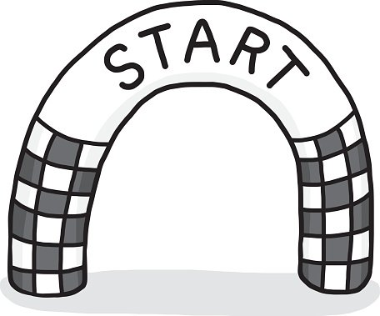
“Begin with the End in Mind.”
Stephen Covey, Author of The 7 Habits of Highly Effective People
Start
Finish

Slide 2
Class Agenda
Announcements
Late Paper Policy
Module Questions
TPE Topic

Slide 3
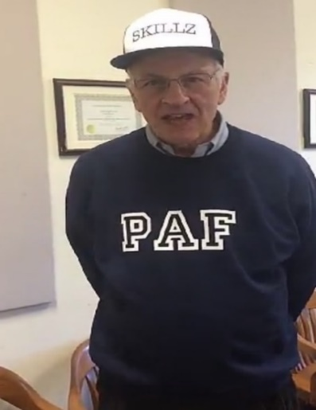
Competition Points
Groups | Points
1 | 1
2 | 1
10 | 1
11 | 1
12 | 1
17 | 1
3 | 0
4 | 0
5 | 0
6 | 0
7 | 0
8 | 0
9 | 0
13 | 0
14 | 0
15 | 0
16 | 0
Winners
Losers
As of 8/31/2020

Slide 5
Module 1 Newsletter
Look at the Module 1 Newsletter on Blackboard
It will guide you to an A on your paper

Slide 6
Late Paper Policy
All papers are due at 12:45 p.m. Any paper received after 12:50 p.m. on the designated day will be considered late.
You will lose 5 points if the paper is received by 4:30 PM on the due date.
After the due date, late modules should be emailed to your TA at the beginning of the next class. If it is turned in by the following class, you will lose an additional 20 points.
Late modules will not be accepted past 12:45 PM one class following the original due date.
Computer problems are not accepted as excuses. The module five paper must be emailed to your TA by 12:45 PM on the last day of classes.
You will receive a zero for the module five paper if it is not in by 12:45 PM, even if you get hit by a truck!

Slide 7
TPE Topic
Too many underage SU students are drinking alcohol.
Notes:
SHOW THEM IT

Slide 8
TPE Assignment
Write a memo to Robert D. Hradsky, Associate Vice President of the Student Experience and Dean of Students proposing a policy to reduce underage drinking among SU students
Group TPE Assignment #1 MUST be emailed to your TA by 12 PM on 9/2

Slide 9
Team Policy Exercise Project
Wednesday 9/2: Assignment #1 due at 12:00 PM to your TA. Students meet in groups to work on Assignment #2. Rough draft of Assignment #2 developed by the end of class and sent to TA.
Friday 9/4: Meet in TPE Groups. Final draft of Assignment #2 due by 2:00 PM to Coplin and your TA.
Saturday 9/5: TPE debriefing by Coplin

Slide 10
Problem and Person Receiving the Memo
Societal problem: Too many underage SU students are drinking alcohol.
Writing Memo to Robert D. Hradsky

Slide 11
For Next Class
Wednesday – go straight to Breakout Rooms working with your TPE group on Zoom
Submit Assignment #1 by 12:00 PM

