Slide 1
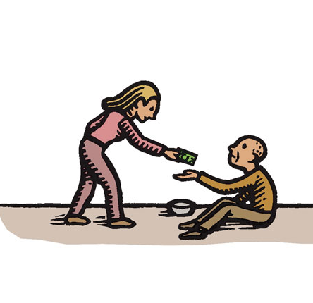
PST 101 Module 1, Lecture 2
“If you do good, people will accuse you of selfish, ulterior motives. DO GOOD ANYWAY.”
Altruism
Self Interest

Slide 2
Class Agenda
Announcements
Module 1
Mother Teresa and Doing Good
Mr. Jefferson Gets a F
Problems and Priorities
The Limits of Freedom
Order, Freedom and Equality
Next Class Assignment

Slide 3
Microsoft for Macs
Microsoft Office is FREE for all SU students even if you have MACS
Be a winner and download Microsoft Office
https://www.microsoft.com/enus/education/products/office

Slide 4
Slides Available Online
Slides will be posted to Blackboard after each lecture
To be used for reference on your module papers – NOT as a substitute for attending class
Because we are 100% ONLINE there should be no excuse for missing lectures. If you have a conflict that will prevent you from attending, please notify your TA well in advance of your absence

Slide 5
Coplin’s Monologue: Doing Good
https://www.youtube.com/watch?v=mgJMi5X-S5M

Slide 6
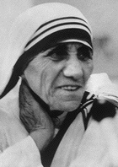
Mother Teresa
August 26, 1910 - September 5, 1997
“Do not wait for leaders; do it alone, person to person.” — Mother Teresa

Slide 7
Leader of the Order of the Missionaries of Charity
“I choose the poverty of our poor people.
But I am grateful to receive (the Nobel) in
the name of … people that have become a
burden to the society and are shunned by
everyone."
Nobel Peace Prize in 1979 for humanitarian work
Leader of Missionaries of Charity, Calcutta
Was in India at the time of the award

Slide 8
A Story About Mother Teresa
She asks a rich businessman for a contribution as she held out her right hand
He spit in her hand
How did she respond?
Notes:
She says “that’s for me” and holds out her left hand and says “this is for your donation”

Slide 9
Was Mother Teresa a Do-Gooder?
Use the chat feature or raise your hand to share ideas and educate Coplin

Slide 10
Mother Teresa –A Genuine Do-Gooder but you don’t have to be her
Be Selfless – No
Give it your all – No
Be competent – Yes
Notes:
Note:
1) Curse: pure motives
2) Curse: total commitment
3) Blessing: Tough cookie
HYCH Chp #1

Slide 11
Public Policy Is About Doing Good
The Declaration of Independence is the mission statement for our public policy in the U.S.
It is the framework for the Public Interest

Slide 12
Three Values of the Declaration of Independence
Life
Health and Personal Safety
Liberty
Speech and Choice
Pursuit of Happiness
Economic Opportunity
Clean Environment

Slide 13
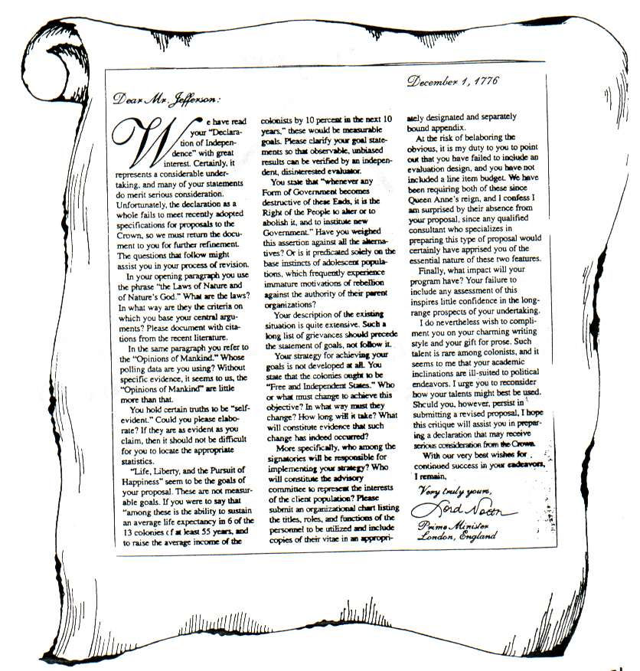
Declaration of Independence
In your opening paragraph you use the phrase “the Laws of Nature and Nature’s God.” What are these laws? In what way are they the criteria on which you base your central arguments?
In the same paragraph, you refer to the “opinions of mankind.” Whose polling data are you using?
If they are as evident as you claim, then it should not be difficult for you to locate appropriate statistics.
I hope this critique will assist you in preparing a declaration that may receive serious consideration for the crown.
Notes:
Note: Click in Paragraphs
1) Dec. of Ind. Is about life, liberty, and pursuit of happiness for all
2) Lord North’s Critiques
3) Ask about appropriateness of critiques
4) Not good public analysis according to North
5) Emotion versus reason
6) Students should have Jefferson’s heart with North’s abilities
7) Remember- EVERYTHING is bullshit

Slide 14
Discussion
Lord North’s Attack on TJ
Use the chat feature or raise your hand to share ideas and educate Coplin

Slide 15
Propaganda Versus Analysis
Propaganda consists of emotion-laden words that seeks to generate support or opposition.
Good analysis consists of:
1. Data
2. Clear language
3. Listener decides

Slide 16
Effective Public Policy Requires
Enlightened Self-Interest
Solid information and analysis
Problem-Solving

Slide 17
Why We Fall Short of the Goals of the Declaration of Independence
Foolish Freedom
The pursuit of freedom as an end, in itself, threatens every person and the public interest.
Notes:
MY LIST IS SELFISHNESS AND POVERTY

Slide 18
Examples of Foolish Freedom
Substance abusers
People who text while driving
Radar detectors
People who refuse to work
Criminals of all kinds
Business leaders who care only about the bottom line
Politicians whose top priority is to win at all costs
Students who use their smartphones in class to stimulate themselves

Slide 19
Freedom Should Not Be an Absolute Value
“Give me liberty or give me death”
-Patrick Henry
Notes:
Live free or die—BS on NH license plates

Slide 20
Should You Wear Seatbelts?
Notes:
If people don’t wear seatbelts, deaths and insurance rates will go up → disrupts order and equality

Slide 21
Underlying Tensions
Order
Freedom
Equality
Think about what the priority among these three values should be throughout the course
Notes:
If you think XYZ is the most important raise your hand

Slide 22
Priorities are a Bitch
In your personal life, confusion over priorities creates poor decisions
In government, nonprofits and business, disagreements are always over priorities

Slide 23
For Next Class (and Time Management!)
Try to complete Exercises 1.1 and 1.2 before next class (but don’t submit)!
Module 1 Exercises are available on Blackboard under ‘Content’ -> ‘Module 1’

